Slide 1
STM Design Project Guide for Lab Sessions
Key Venues Phys E Lab S11-03-02 (G1-4)
Dry Lab 5 S12-03-02 (G5-6)
ESP/CIBA Nanofab Lab S7-01-03 (G1-6 Fabrication)
Physics Workshop S11 Level 1
A/Prof. van Kan’s Office S13-02-02
TAs Badri Narayanan Ravichandran (Nano Lab)
Gokul Nathan (Dry Lab 5)
Neo Kai Wen Jevon (Phys E Lab)
Tan Huei Ming (Dry Lab 5)
Online Platform Luminus (for upload of deliverables)
Microsoft Teams (class & group channel)
http://teams.microsoft.com/

Slide 2
Layout & Content of this Guide
Color Code | Slide Section | Audience
 | Admin, SAFETY & Inventory | All
 | Getting Started | All
 | Design & Fabrication | Group members at S7
 | Electronics (Analog & Computer-controlled) | Group members at S11/S12
 | Results | All
 | Project Management & Update Meetings | Group leaders
 | Log Books | Group members
 | Presentation, Report & References | All
This project is multidisciplinary & organizationally complex. So do prioritise what is relevant to your role but not to the extent of being blinkered.
This lab guide has been drastically expanded further and updated post-covid to help inform and guide you along.
You are expected to do your homework in reading up before coming to lab in Week 8 onwards.

Slide 3
 | ESP 2110 Design Project Sessions (2021)
Week | Dates | Thursday (1530-1800) | Friday (1400-1700)
1 | Thur 14 Jan – Fri 15 Jan | Robotics Project @ FOE
2 | Thur 21 Jan – Fri 22 Jan
3 | Thur 28 Jan – Fri 29 Feb
4 | Thur 4 Feb – Fri 5 Feb
5 | Thur 11 Feb – Fri 12 Feb
6 | Thur 18 Feb – Fri 19 Feb
Recess | Sat 20 Feb – Sun 28 Feb | Recess Week 1
7 | Thur 4 Mar – Fri 5 Mar | 1 hr Orientation + 1 | 0.5 hr Orientation + 2.5
8 | Thur 11 Mar – Fri 12 Mar | 2.5 | 3
9 | Thur 18 Mar – Fri 19 Mar | 2.5 | 3
10 | Thur 25 Mar – Fri 26 Mar | 2.5 | 3
11 | Thur 1 Apr – Fri 2 Apr | 2.5 | Good Friday
12 | Thur 8 Apr – Fri 9 Apr | 2.5 | 3
13 | Thur 15 Apr – Fri 16 Apr |  | Presentation
Reading | by 1800 Mon 19 Apr | Report, Logbook & Feedback upload deadline

Slide 4
Student Groups
Group 1
No. | NAME
1 | MITZI CHONG LYNN YEN
2 | DAI TIANYU
3 | KOH MUI HAO, Andy
4 | ZIV LOW EN HAO
5 | NIKHIL MENON
6 | Premsanjith Subramani
7 | SEAH YANG RONG
Group 2
No. | NAME
1 | FERNANDO KUMARAGEWATTHAGE RAMODH DEVSHAN
2 | CONSTANCE GAY
3 | ARITEJH GOIL KR
4 | SAI TEJASWI GUDIDENI
5 | TAN JIA JUN BRYAN
6 | TAN YAN WEE, RAYNER
7 | Yuen Sheng Hao
Group 3
No. | NAME
1 | GOH KHENG XI, JEVAN
2 | Lee An Min, Amanda
3 | LEE WEI YEE ADRIANNE
4 | LOKE MAY CHEE
5 | MILES SU HAO PENG
6 | THOMAS TAN JUEN KAI
7 | YE JIAYING
Group 4
No. | NAME
1 | ANG Guang Jun Nicholas
2 | CHUA Wei Pin
3 | LI XIAOYUE
4 | LOCK MEI LIN
5 | PATWARI SMRIDHI
6 | TOH WEI WEN
7 | WONG HAN SHENG
Group 5
No. | NAME
1 | IRWIN CHIN DE TAO
2 | GOH JANICE
3 | GOH ZHONG XIAN LIONEL
4 | LI CHUAN
5 | BRANDON LOKE SHUEN YI
6 | SUN HUI RONG
7 | RYAN TANG LI YEN
Group 6
No. | NAME
1 | NIKITA GOH MEI XIAN
2 | Kelleen Koh Jia Xuan
3 | LOH JIA YING WHITNEY
4 | SEE HAK GUAN, ALFRED
5 | RYAN TAN RUI YANG
6 | TOH JIA-YIH RONALD
*Grp leader + 2/3 update Jeroen on off shift day during lab sessions via Teams (10-15 mins).
You are free to choose your role & shift. Do coordinate with your shift counterpart to ensure task handover is smooth.
Role/Shift Day | Thursday | Friday
Group Leader* | Any 1 day per week
Assembly & test subgroup members (S11/S12) | 2 | 2
Fabrication subgroup members (S7) | 1 | 1

Slide 5
Phys E Layout (Groups 1-4 Assembly & Test subgroups)
Back Entrance
Group 4
Group 3/4 Shared + Microscope
Group 3
Buffer Zone
Storage
Buffer Zone
Group 2
Group 1/2 Shared + Microscope
Group 1

Slide 6
Dry Lab 5 Layout (Groups 5-6 Assembly & Test subgroups)
Back Workbench
Sink
Groups 5/6 Shared Microscope
Group 6
Common Workbench
Group 5
Current Source Testbench
Soldering Workbench
Soldering Workbench
Front Entrance

Slide 7
Nano Lab Layout (Groups 1-6 Fabrication subgroup)
Front Entrance
Occupied
TA
Occupied
3D Printers
Group 1 Group 2 Group 3
CNC Mechanical Workbench
Group 4 Group 5 Group 6
Laser Cutter
Sink

Slide 8
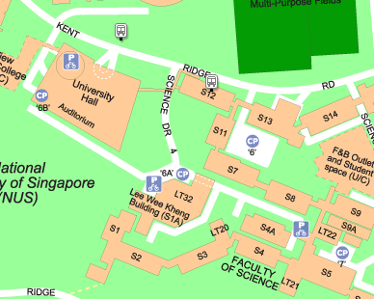
Safety Rules
(Please abide by these safety guidelines as well as our verbal advisories given throughout the semester)
Emergency exit route to Assembly Area at University Hall Sheltered Walkway
Dry Lab 5 S12-03-02
Turn left, head down S12 stairwell to Sci Dr 4 OR
Turn right, head down S12/S13 stairwell and on to Lower Kent Ridge Road then Sci Dr 4
Phys E Lab S11-03-02
From back exit, to S7 3rd floor, turn right to exit to Sci Dr 4 OR
From front exit, head down S12/S13 stairwell and on to Lower Kent Ridge Road then Sci Dr 4
ESP/CIBA Nanofab Lab S7-01-03
Turn right, go up S7 stairwell to 3rd floor and turn left to exit to Sci Dr 4
Turn left, exit S7, up back staircase towards S4A to Sci Dri 4, turn right to walk towards assembly area

Slide 9
Safety Rules
Attire
Clothing must offer good protection against direct chemical spills and physical scratching.
Clothing should cover your upper arms, waists and legs.
Do not wear excessively loose and flowing clothing.
Shoes should cover feet and toes fully
Hygiene
Make sure to do your temperature declaration before coming to lab, and scan the QR code for attendance
Keep your face masks on at all times!
Wash your hands before and after coming to lab!
Do not consume food and drinks in the lab.

Slide 10
Safety Rules
Working in Lab
Keep your bags under your workbench.
“Ask if you are unsure”, do not misuse the any of the provided equipment
Operate only if you are confident with Standardised Operating Procedures (SOP) of the equipment
Clarify with your instructors, if you are unsure

Slide 11
Safety Rules
Working in Lab
‘As if you were never here’, at the end of every lab session:
Power off your group PC and electrical equipment.
Return your hand tools to its storage compartment.
Store your setup.
Clear your workbench/floor of any waste material.
Failure to do so will result in penalties.
Do not remove your prototype, equipment and tools from the lab!

Slide 12
Group Equipment
1x Dell PC (with Monitor, Wi-Fi antenna, keyboard & mouse) (SGD 2k)
Installed with Dassault Systems SOLIDWORKS and National Instruments LabVIEW
1x National Instruments USB-6211 DAQ Card & USB cable (SGD 1.5k)
1x Analog Electronics Prototyping Unit (SGD 500)
Useful to get ±15 V DC voltages, 5V DC voltage and analog (square, triangular, sine) waveforms up to 100 kHz
1x Keithley 2231A-30-3 Programmable DC Power Supply (SGD 2.1k)
1x HIRSCHMANN 934160101 Test Lead, 0.64mm Square Pin Socket to 4mm Banana Plug, Red, 60 V, 3 A, 1 m (SGD 9)
2x HIRSCHMANN 934160100 Test Lead, 0.64mm Square Pin Socket to 4mm Banana Plug, Black, 60 V, 3 A, 1 m (SGD 15.5)
1x HIRSCHMANN 973644100 Test Lead, 4mm Banana Plug to 4mm Banana Plug, Black, 60 V, 16 A, 250 mm (SGD 17.4)
1x Fluke-101 Digital Multimeter (SGD 50)
1x HT-225D Crimping Tool (SGD 32)
1x Metric Allen Key Set (SGD 7)
1x Pro’s Kit 1PK-302N-F (SGD 73)
1x Precision Screwdriver Set (misc. manufacturer) (up to SGD 25)
list prices per unit, excluding shipping costs & GST

Slide 13
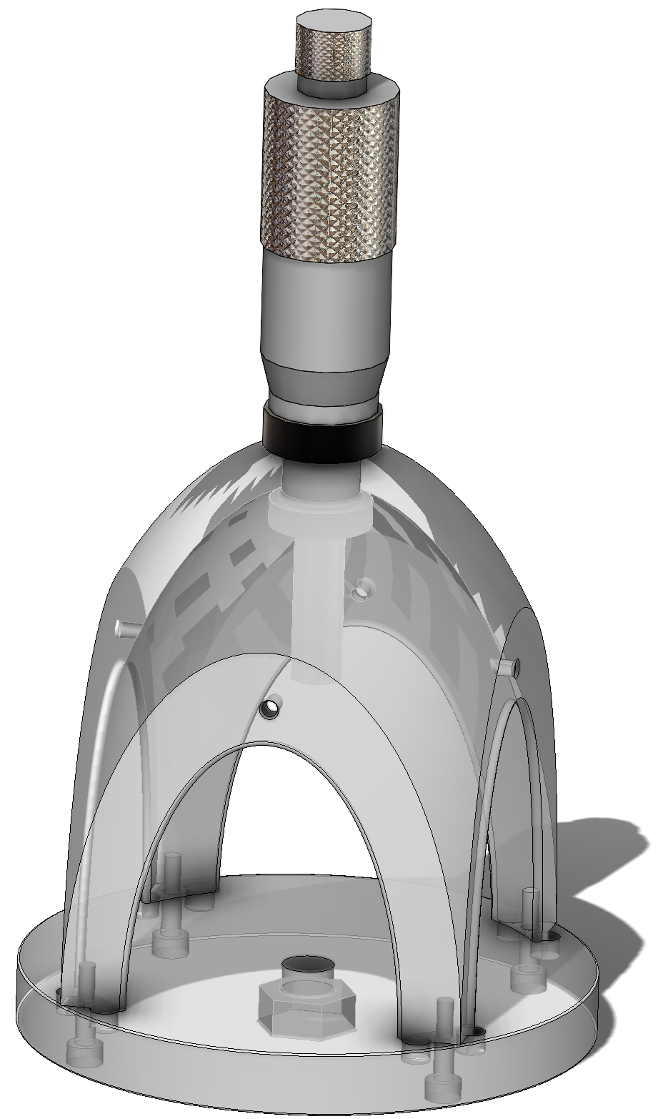
Group Base Mechanical Setup
Direct approach with 1 µm/div micrometer (SGD 500)
You are given:
1x Mitutoyo 110-101 Micrometer* & Locking Ring* (SGD 500)
1x ø90 mm CNC machined 6061 aluminium base plate*
1x Dome body* (3D Printed, Colorfabb_HT material)
4x Door* (CAD only provided)
4x RS PRO, M3x10 mm Pan Head Nylon Screw
4x RS PRO, M4x10 mm Nylon Thumb Screw
*Solidworks part and assembly files are provided.
This helps you to further develop your assembly & check if your designed parts will fit in the assembly before fabrication.
10 mm
You cannot make permanent modifications to base parts provided!

Slide 14
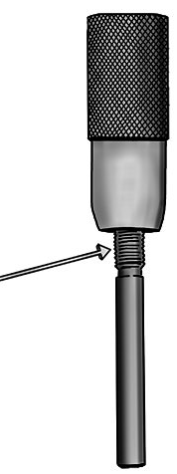
Note on Micrometer Handling
A micrometer’s accuracy is due to precisely machined threads, one on the spindle and the other on the thimble. Applying a force along the length of the micrometer can damage the threads!
Based on ‘Mitutoyo Head Guidelines’, loading limits should be within 2 kgf.
For comparison, poking with an index finger can create about 4 kgf! (Source: International Encyclopedia of Ergonomics and Human Factors - 3 Volume Set pg 372).
The ‘Mitutoyo Head Guidelines’ document also provides mounting guidelines.
Thimble
Threaded spindle
Image credit:
https://www.wonkeedonkeetools.co.uk/micrometers/how-does-a-micrometer-work

Slide 15
Common Equipment & Tools (Mechanical)
6x SOLIDWORKS PCs
Measuring Tool (in ESP/CIBA Nano Lab)
3x Mitutoyo 500-196-30 Digital Calipers (Resolution 0.01 mm) (SGD 228)
Cutting Tools (in ESP/CIBA Nano Lab)
1x FEIN MultiMaster Cordless Cutting Tool (USD 359)
1x DEWALT DWHT20547L 5-in-1 Hacksaw (USD 29)
Clamping Tools (in ESP/CIBA Nano Lab)
1x Bessey S10 G7011 Vise Clamp (USD 27)
2x Bessey DUO16-8, DuoKlamp Adjustable Bar 6” Clamp/Spreader (USD 19)
4x Bessey XCR Ratcheting Spring 2” Clamp (USD 67)
list prices per unit, excluding shipping costs & GST

Slide 16
Common Equipment & Tools (Electrical)
1x Rohde & Schwarz 100 MHz RTB2004 Digital Oscilloscope (SGD 4.2k)
4 analog channels & 4x ZP-03 passive probe
16 digital channels & 2x RT-ZL03 8-ch logic probes
RTB-B1 mixed signal software upgrade
RTB-B6 arbitrary waveform generator software upgrade
1x Keithley 6221 DC & AC Current Source (SGD 11.8k)
1x Keithley model 7078-TRX-GND 3-slot Male Triax to Female BNC Adapter Keithley model (guard removed) (SGD 156)
1x Hirschmann 933844001 Test Lead, BNC Plug to 0.64mm Square Pin Sockets x 2, 60 V, 1.2 m (SGD 9.4)
Soldering Tools
2x Knipex 12 42 195 Automatic Wire Stripping Tool (USD 96.73)
3x Goot KX-60-R Soldering Iron & Stand with sponge pad, and helping hands (SGD 100/kit)
list prices per unit, excluding shipping costs & GST

Slide 17
Electrical Consumables
STM Preamp PCB
with Texas Instruments 8-pin LF411 ICs (replaceable if broken) (SGD 2.18)
STM Integrator PCB
with Texas Instruments 14-pin TL074CN ICs (replaceable if broken) (SGD 1.48)
AWG24 Electrical Wires 7x0.2 mm tinned copper 30.5 m reel (SGD 40)
Black Blue Red Green White Yellow colors
50Ω Coaxial cable
For making crimp connections:
Multicomp 2226TG Contact, Socket
Multicomp 2226A-0X Crimp Housing
2, 3, 5 Channels
Black/Clear Heat Shrink Tubing 2:1, 2.4 mm (use this single channel crimped wires)
Potentiometers (SGD 2.3-2.8):
P231-QC20BR10K Rotary Potentiometer, Conductive Plastic, 10 kΩ, 0.5 W, ± 20%, 1 Turn, Linear (SGD 2.8)
P231-QC20BR100K Rotary Potentiometer, Conductive Plastic, 100 k Ω, 0.5 W, ± 20%, 1 Turn, Linear (SGD 2.3)
list prices per unit, excluding shipping costs & GST

Slide 18
Common Equipment & Tools (Vibration Isolation & Microscopy)
5x MinusK 25BM-4 Vibration Isolation Platform (USD 3.1k)
Aluminium plate set totalling 11 kg (one each of 0.5 kg, 1.0 kg, 2.0 kg, 2.5 kg, 5.0 kg)
1x Weighing Scale T28-15k (Weighing range 0.002 - 15 kg) (SGD 200)
BRÜEL & KJÆR Type 2250 Hand-held Analyzer (https://www.bksv.com/-/media/literature/Product-Data/bp2025.ashx)
TYPE 8344 0.2 – 3000 Hz PIEZOELECTRIC ACCELEROMETER (SGD 14k)
TYPE 4189 ½” FREE-FIELD MICROPHONE, 6.3 HZ TO 20 KHz, PREPOLARIZED (SGD 2.5k)
3x Olympus BX-51 Optical Microscopes (SGD 8k/package)
Each with a USB Microscope Camera
Each with 5x, 10x, 20x, 50x, 100x objective lenses
list prices per unit, excluding shipping costs & GST

Slide 19

Your Goal
To manage complexities from organizing a team and bridging disciplines to assemble a setup that can get a metal tip to within stable tunneling distance of a metal surface.
Image credit: Britishcarbon.org

Slide 20
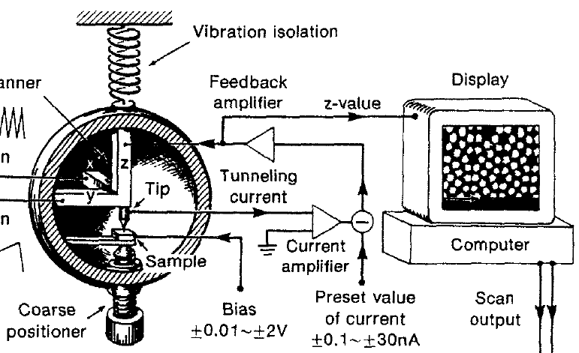
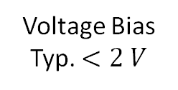
Scanning Probe Microscopy Schematic
Main tasks:
Design, fabricate & assemble mechanical assembly containing (piezo, tip, sample, coarse positioner)
Test & assemble electronic circuitry for closed-loop control of tip-sample distance.
Use computer-controlled data acquisition hardware/software to log measurements.
Work together to integrate subsystems, document results, plan improvements and iterate.
(~10nA)
Current to Voltage Amplifier
Voltage Bias
Typ. $<2 V$
Set Point
Voltage
C. Julien Chen. Introduction to Scanning Tunneling Microscopy
Notes:
Highly recommended reading: Home-Built STM | Dan Berard. If you don’t understand how the technical bits come together, this blog is very much worth a read.

Slide 21
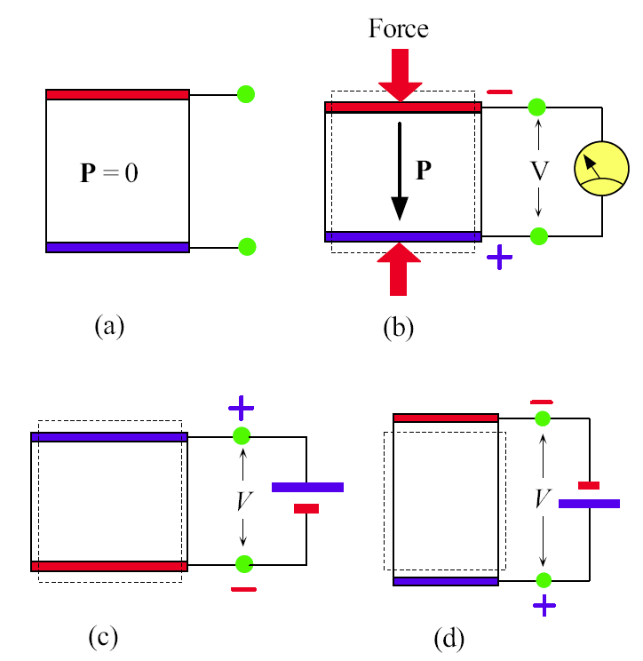
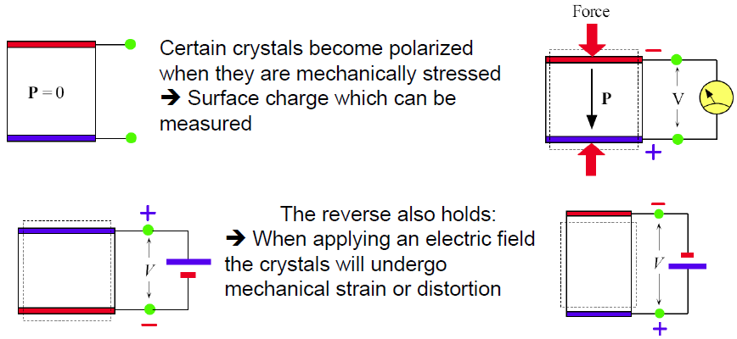
1. Measuring Piezoelectric Disc Deflections
What is piezoelectricity?
at the atomic level <1 µs.
More details will be discussed in PC2133 Applied Solid State Physics

Slide 22
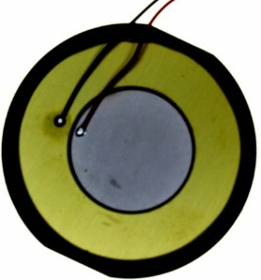
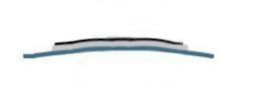
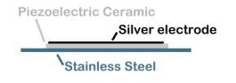
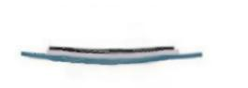
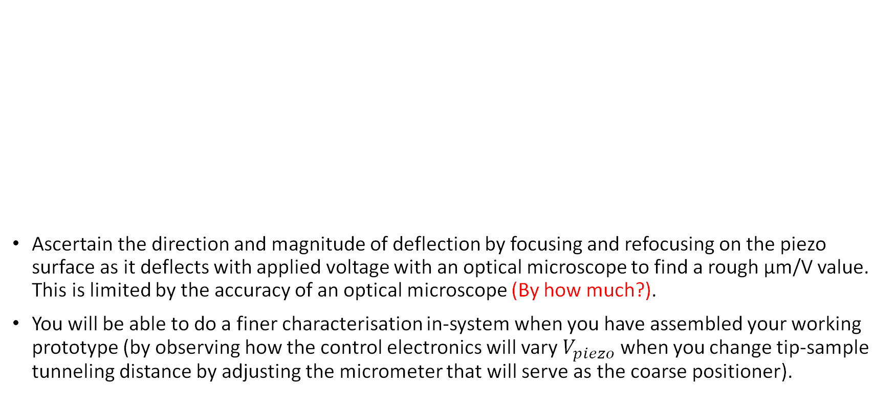
1. Measuring Piezoelectric Disc Deflections
Ascertain the direction and magnitude of deflection by focusing and refocusing on the piezo surface as it deflects with applied voltage with an optical microscope to find a rough µm/V value. This is limited by the accuracy of an optical microscope (By how much?).
You will be able to do a finer characterisation in-system when you have assembled your working prototype (by observing how the control electronics will vary $V_{piezo}$ when you change tip-sample tunneling distance by adjusting the micrometer that will serve as the coarse positioner).
Notice the ABS ring& silicone adhesive at its sides. This allows you to mount the piezo yet be able to deflect up and down with ease.
How you mount your piezo securely is crucial for accurate characterisation of deflection!
Piezo Model Number | APS4812B-LW100-R
Drawing & Specifications | http://www.puiaudio.com/pdf/APS4812B-LW100-R.pdf
V+ Bow Up V+
V- Bow down V-
V- Bow Up V-
V+ Bow down V+
Schematics by John D. Alexander.

Slide 23
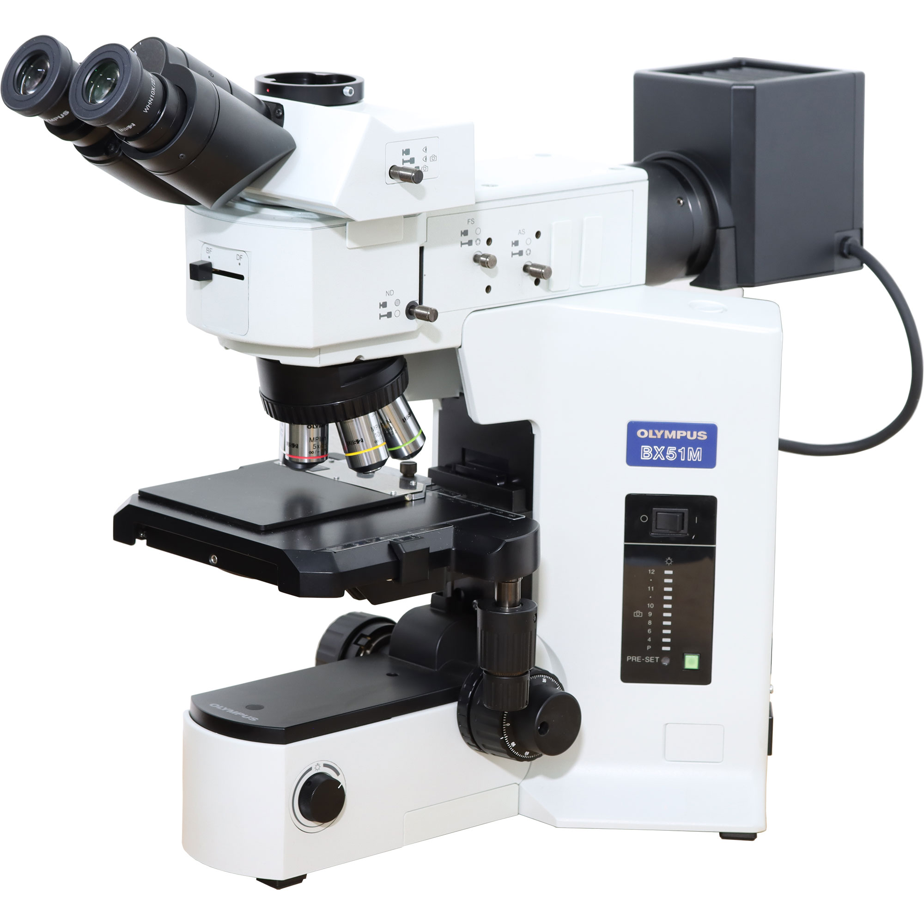
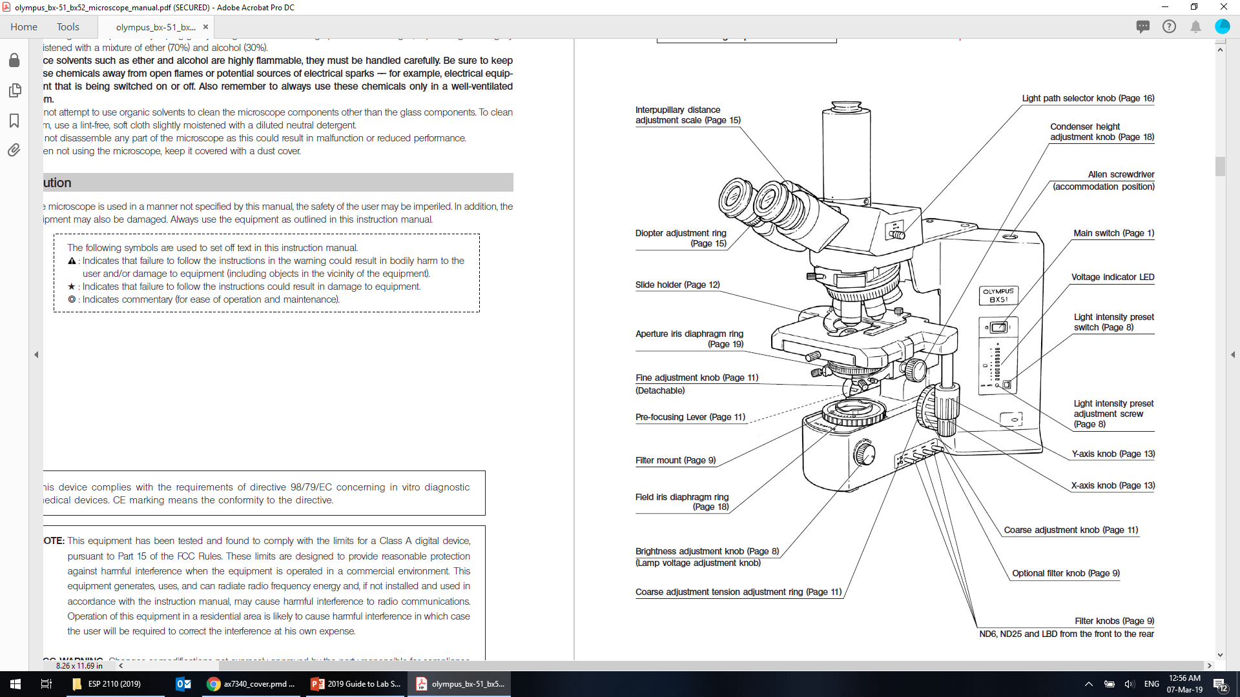
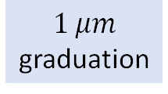
1. Measuring Piezoelectric Disc Deflections
Rotate in increasing magnification
(Why?)
$1 μm$ graduation
https://arf.berkeley.edu/files/webfiles/all/arf/equipment/laboratory/microscope/oly_bx51/olympus_bx-51_bx52_microscope_manual.pdf

Slide 24
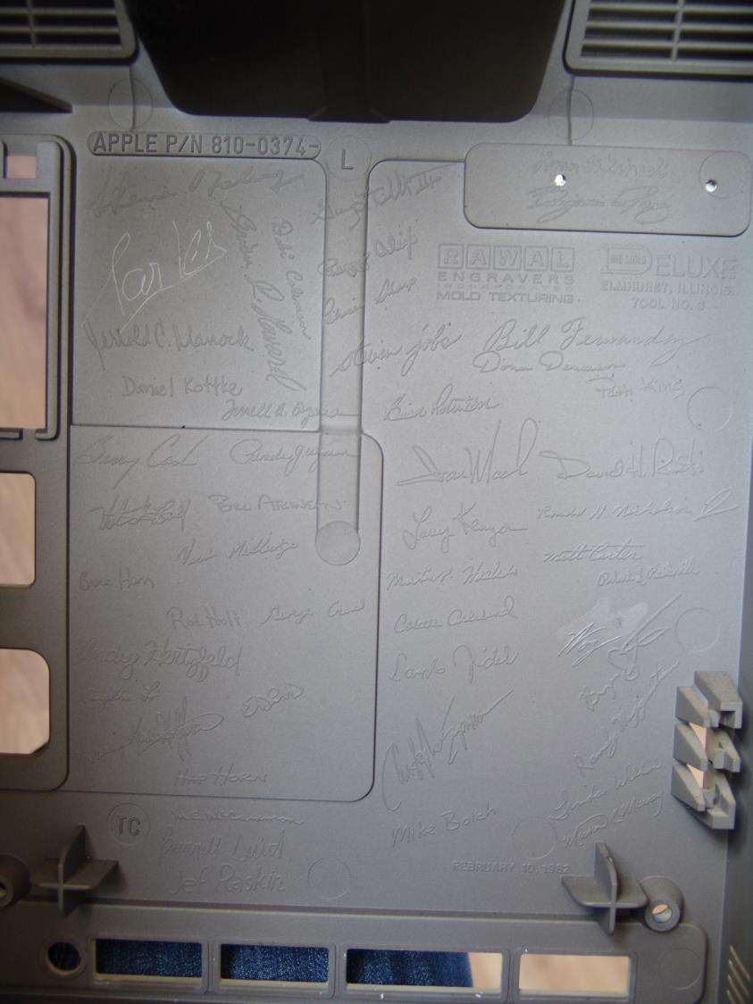
Craft, Above All
“When you’re a carpenter making a beautiful chest of drawers, you’re not going to use a piece of plywood on the back, even though it faces the wall and nobody will ever see it. You’ll know it’s there, so you’re going to use a beautiful piece of wood in the back. For you to sleep well at night, the aesthetic, the quality, has to be carried all the way through.”
- Steve Jobs -
In the process of designing and building, methodical attention to detail and dogged quest for perfection are indispensable traits for success.
Image credit: Wikipedia

Slide 25
Key tasks (not exhaustive!)
Know & understand the pros/cons of the fabrication techniques at your disposal in the Nano Lab.
Design mechanical holders to be able to easily swap piezos, tips & samples.
Piezos: Already documented in Getting Started section
Tips: ø 0.2 mm Cu or ø 0.25 mm Pt-Ir wire
Sample: Au on Cr on Si chip (~5 mm x ~5 mm x 0.5 mm height)
Maintain a Solidworks assembly file for your entire setup.
Fabricate your parts (with TA’s guidance).

Slide 26


2. Mechanical (Design Process)
From notebook…
…to rocket
???
Every engineered item began its design process on paper.

Slide 27
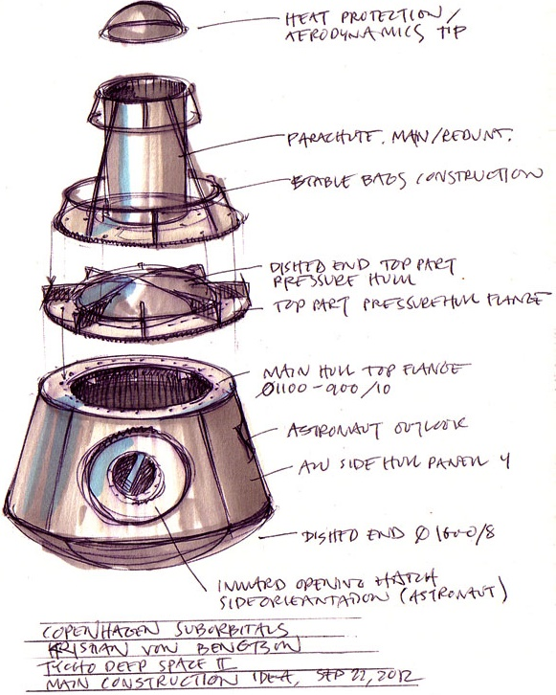
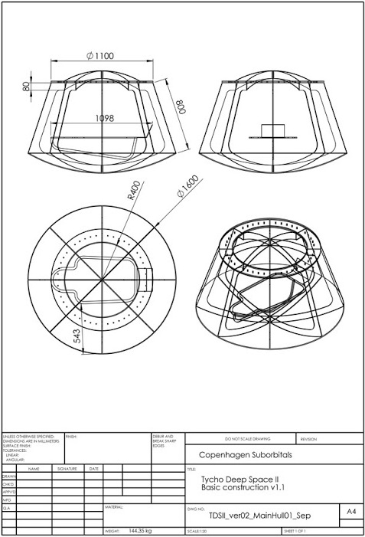
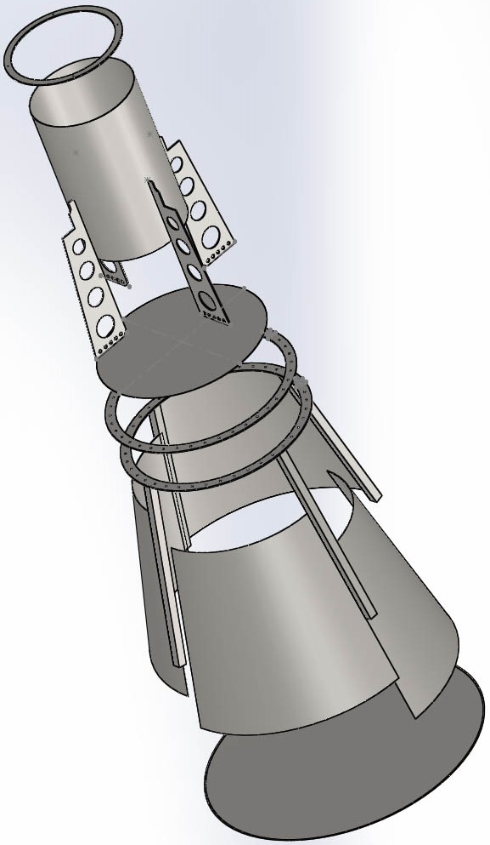
2. Mechanical (Design Process)
Sketch
Drawing
CAD (Solidworks)
(START DOING THIS!)
And then it’s off to be fabricated
???
Remember to document the details as design evolves and specifications converges
http://issuu.com/copsub/docs/cs_sketchbook01
http://www.wired.com/2012/09/alot-of-pressure/

Slide 28
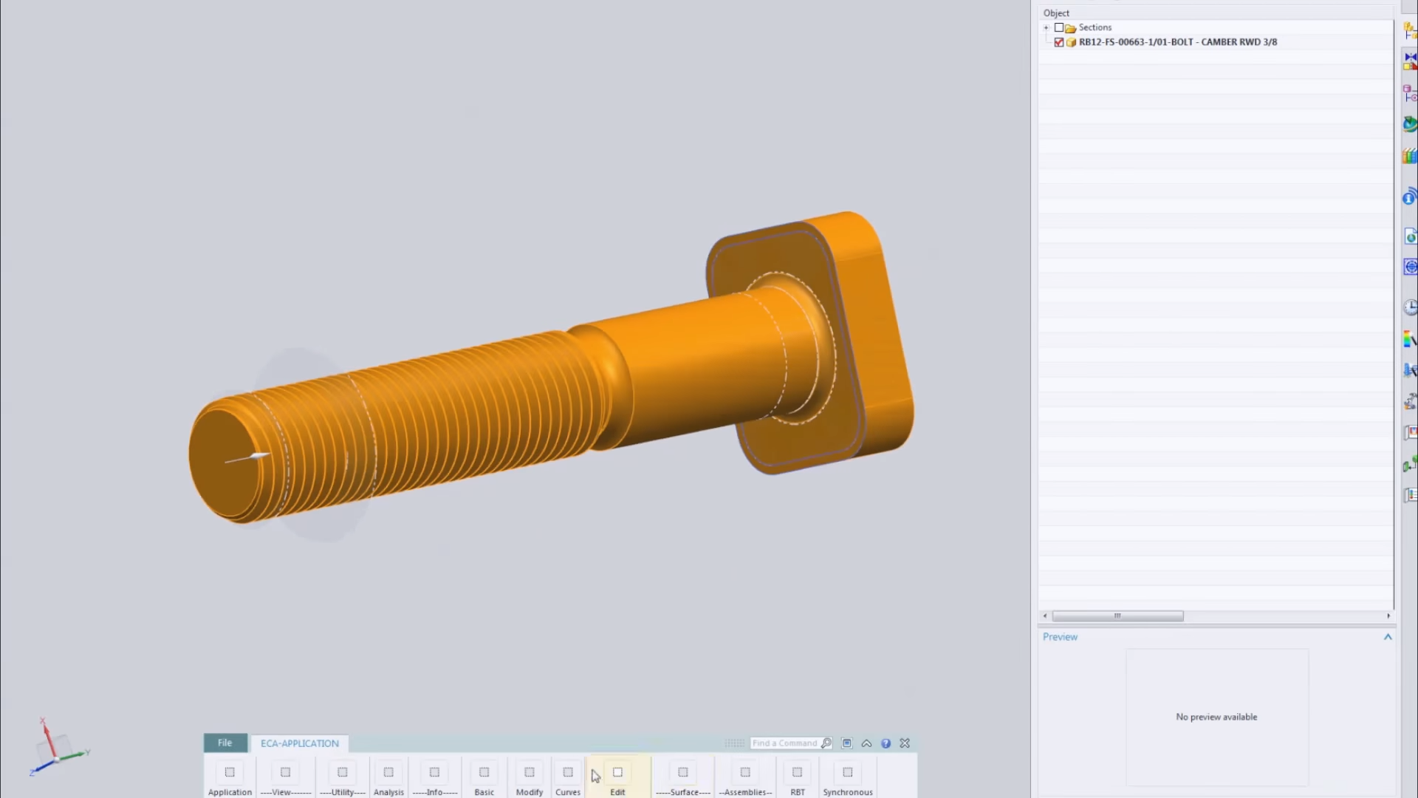
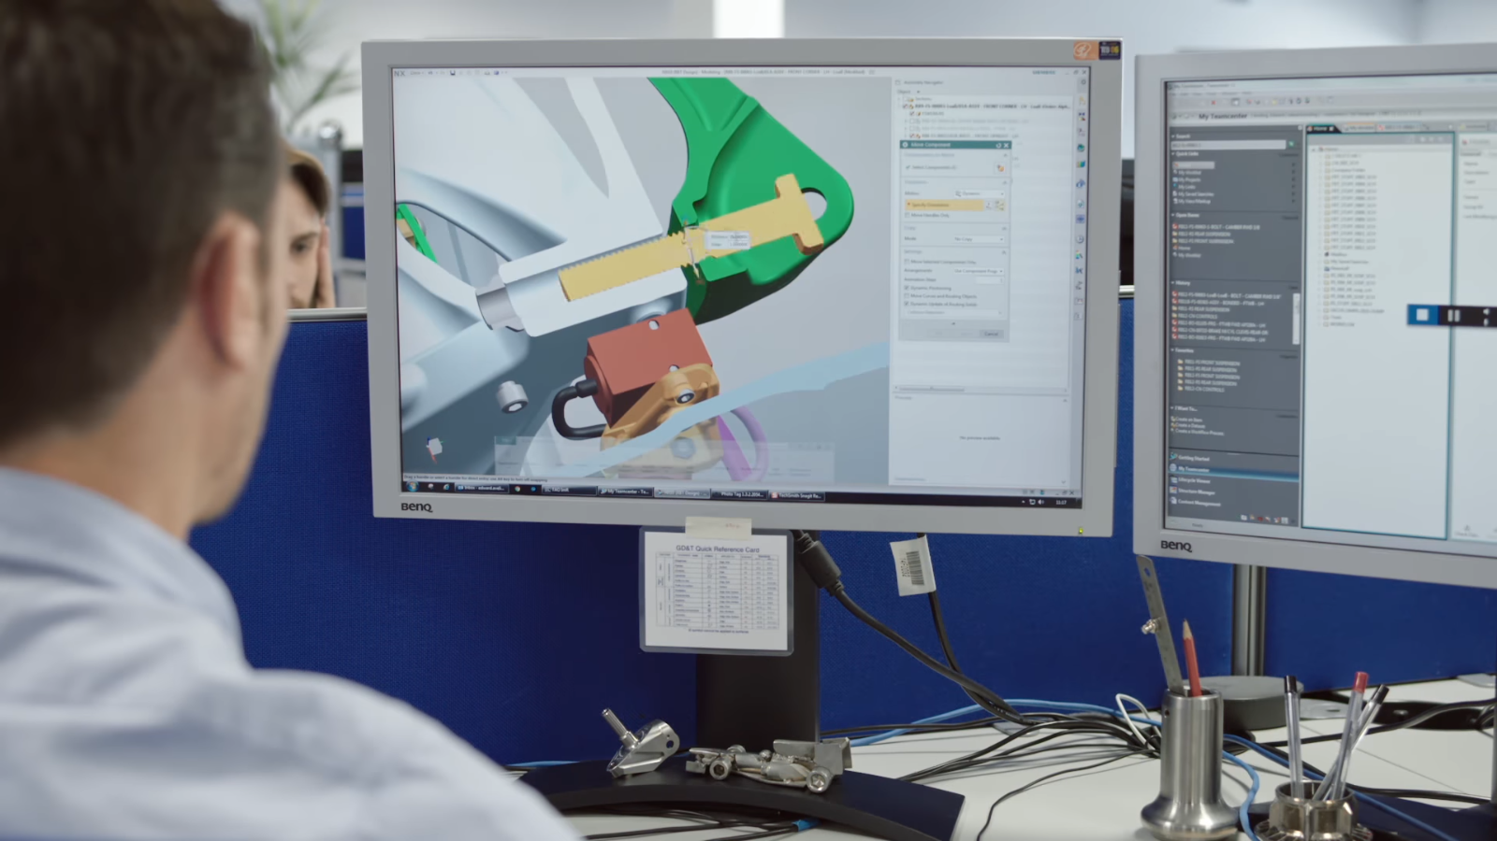
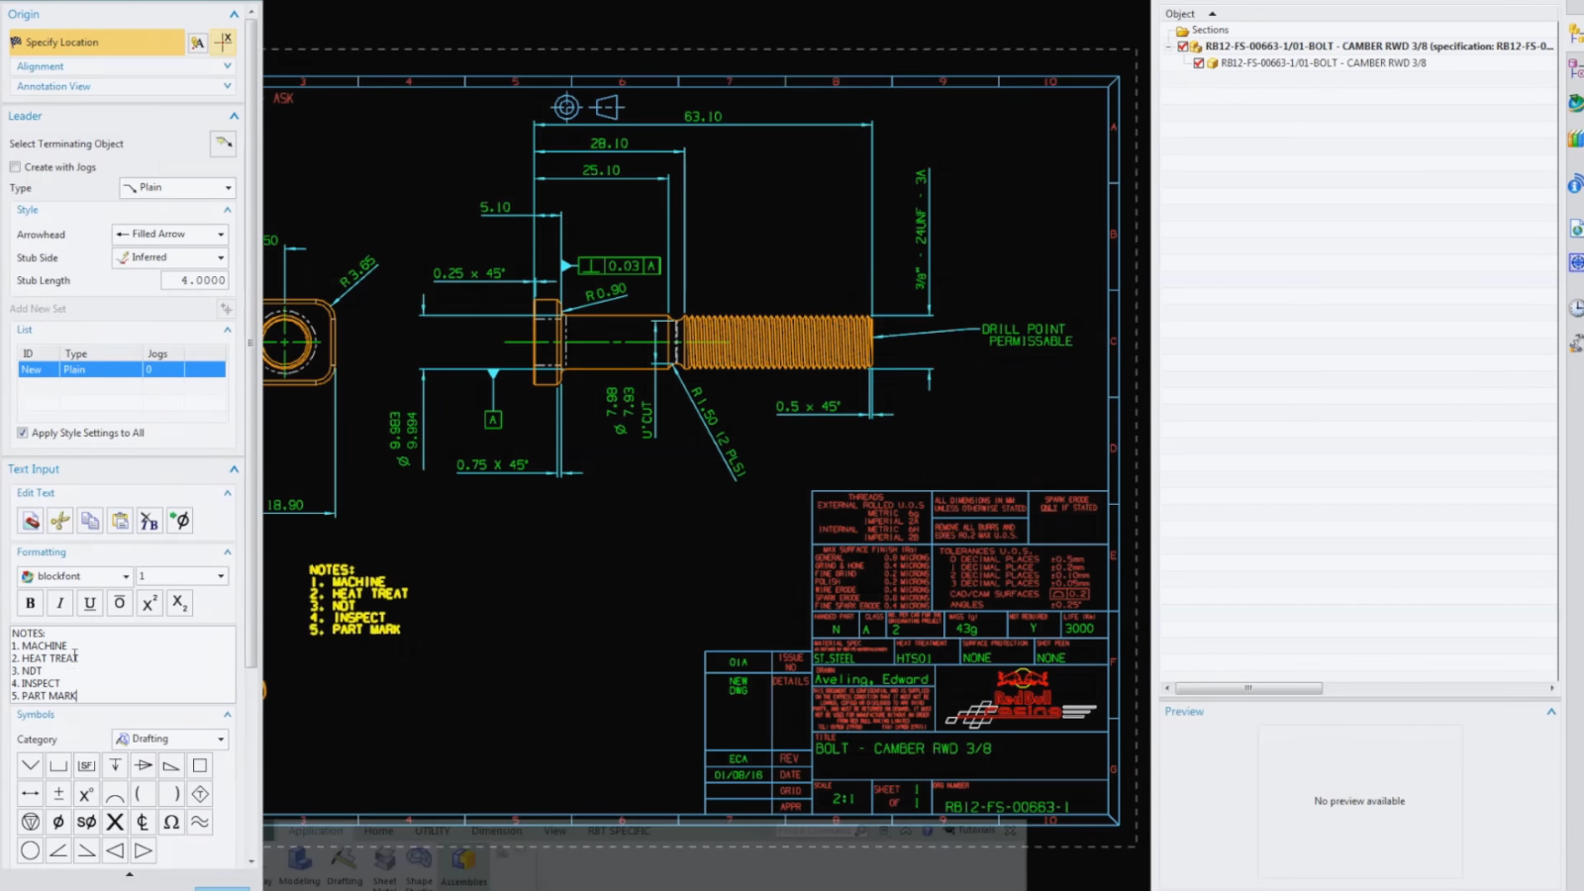
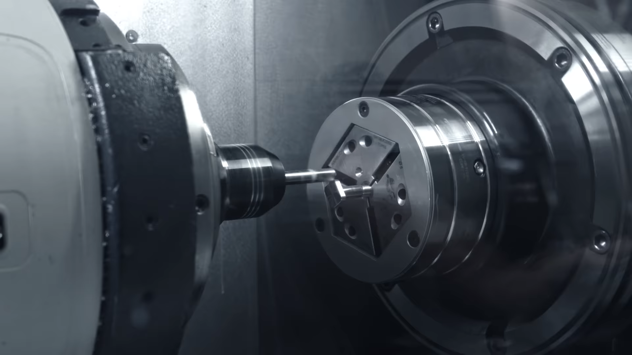
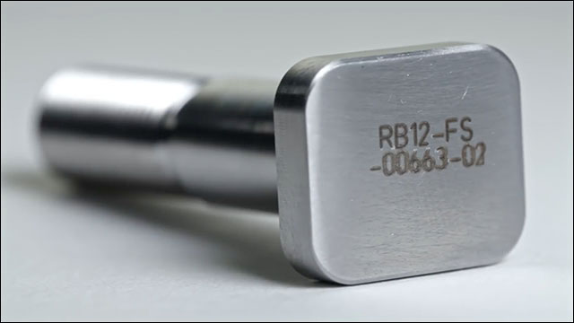
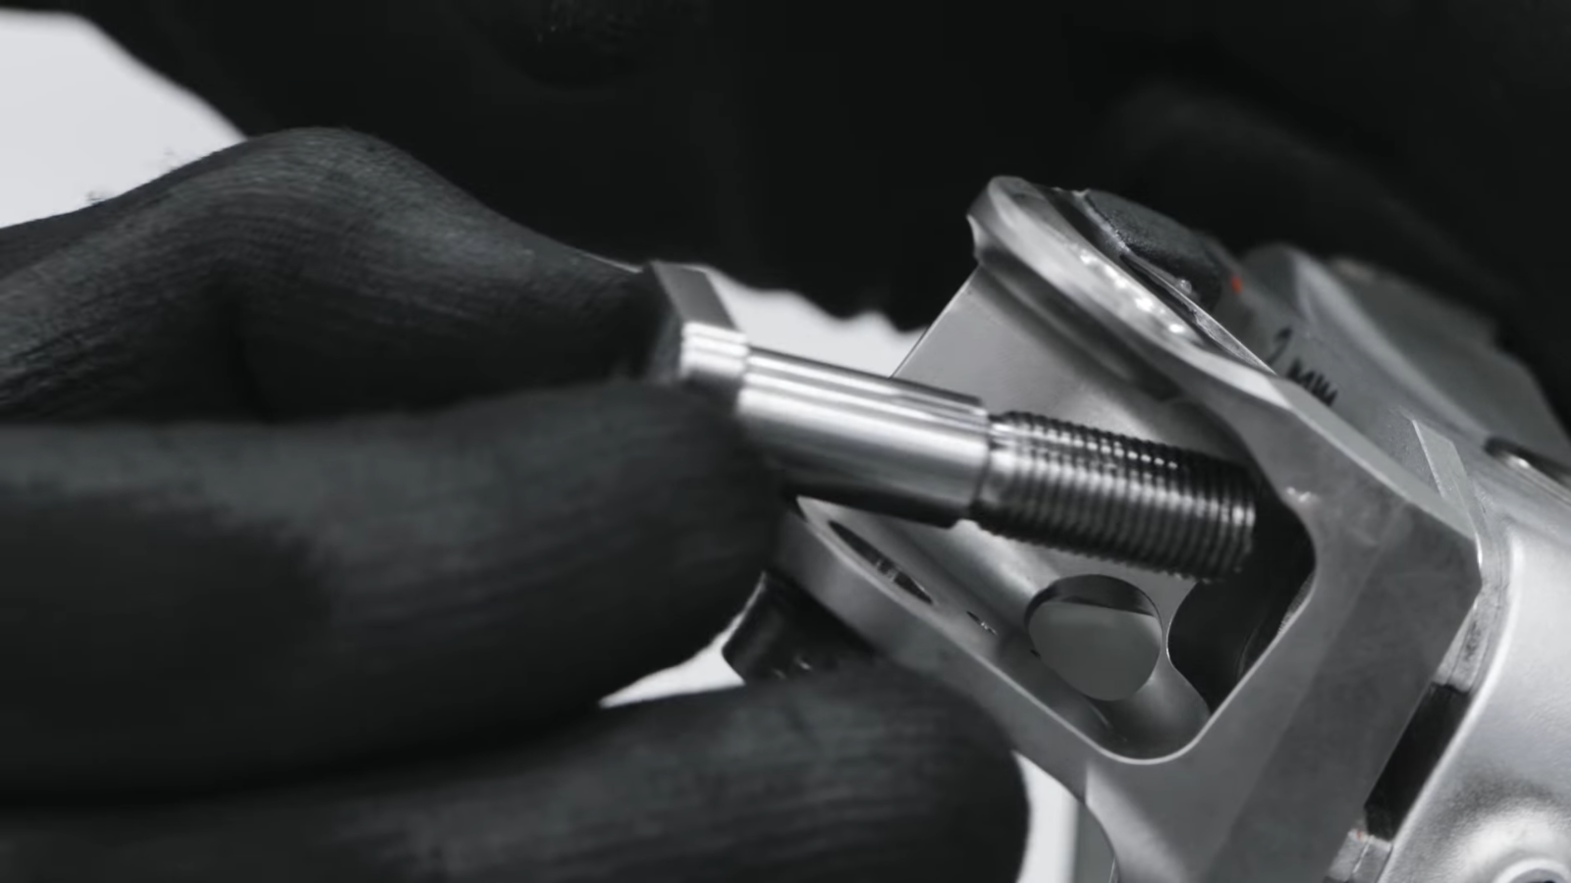
2. Mechanical (Design Process)
In ‘The Life of a Bolt’, you can catch a glimpse of the intricacies involved in the process of turning design into finished part ready for seamless integration into an assembly.
The following slides will provide you with some conventions to guide you along the process of designing your mechanical setup:
Drafting conventions
CAD software and file formats used
Fastener Specifications (Nuts & Bolts)
Fabrication techniques
Material
Image credit Red Bull Racing – The Life of a Bolt video

Slide 29
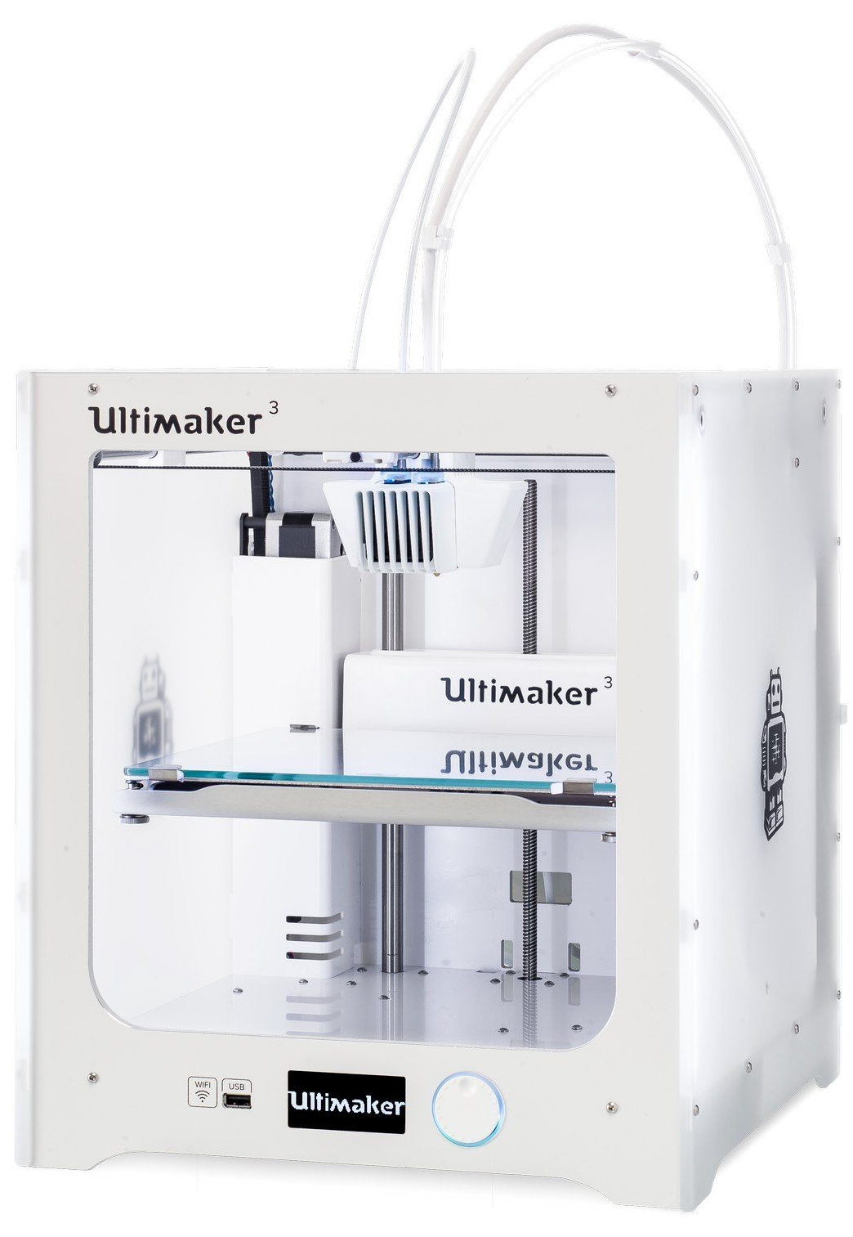
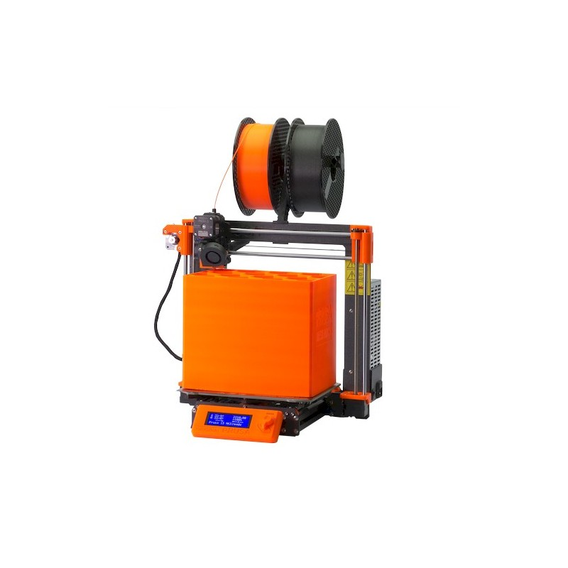
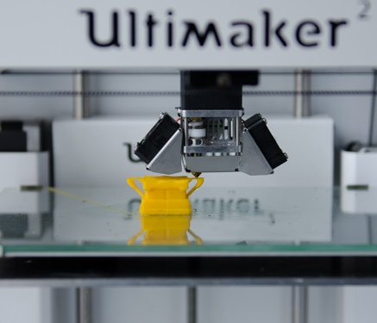

2. Mechanical (Fabrication Equipment)
Ultimaker 3 (SGD 5.5k)
FFF with ABS / PLA
PRUSA I3 MK3S 3D (SGD 1.5k) & PRUSA MINI (SGD 0.6k)
FFF with PLA/PET
Image credit: Shop3D.ca
Image credit: Inhabitat
Image credit: prusa3d.com
Build volume: 230 x 225 x 205 mm³
Lateral resolution (X/Y): 400 µm
Layer resolution (Z): >20 µm
Build volume: 250 x 210 x 210 mm³ 180 x 180 x 180 mm³
Lateral resolution (X/Y): 400 µm
Layer resolution (Z): >40 µm
Use Solidworks (installer file in Teams General Channel Files) to design the model, and output into STL format for both machines!
Then use Cura/PrusaSlicer to plan the print

Slide 30
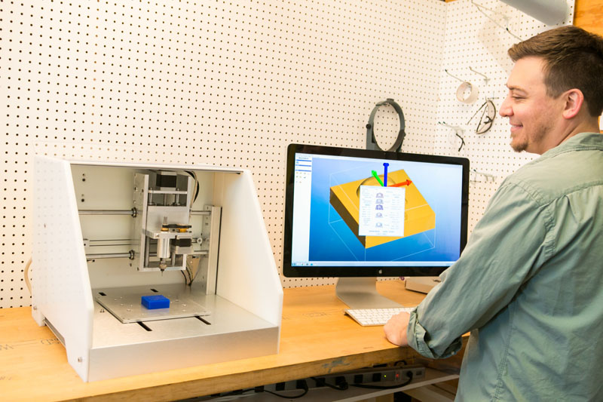
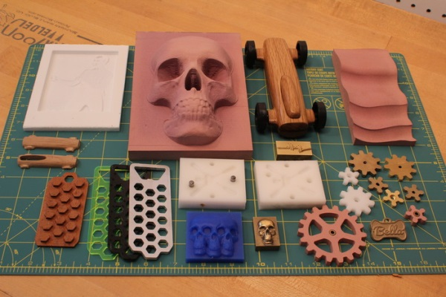
2. Mechanical (Fabrication Equipment)
Carbide3D Nomad 883 Pro Desktop CNC Machine (USD 2.5k)
Processing envelope: 200 (X) x 200 (Y) x 75 mm³
Spindle Speed: 2000-10,000 RPM
Positioning Resolution: ~10 µm
Machining Resolution: ~100 µm
Preferred software for CAD/CAM workflow:
Solidworks & HSMWorks
Only for PMMA/Aluminium!
Carbide 3D
3Ders.org

Slide 31

2. Mechanical (Fabrication Equipment)
Oree Laser O-M 0605 Laser Cutter (SGD 5.5k)
Laser: Reci 90 W CO₂ Laser
Beam spot: ~100 µm
Processing envelope: 600 (W) x 500 (L) mm²
Designed to operate like a computer printer.
Compatible graphics editing software (TBC):
AutoCAD DXF/DWG files
CorelDRAW
Adobe Illustrator CS3 or higher
Solidworks
Only for cutting PMMA sheets <10 mm thickness!
You can also try approaching Mr. Anuwar/Mr. Tay at the FOE Fab Lab (E4-02-06) to use the Epilog laser cutter there.

Slide 32
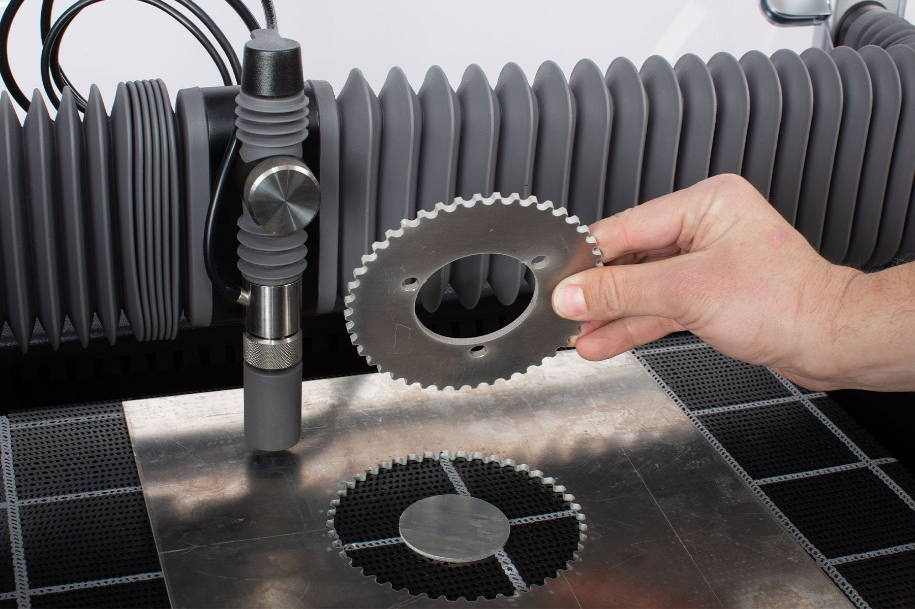
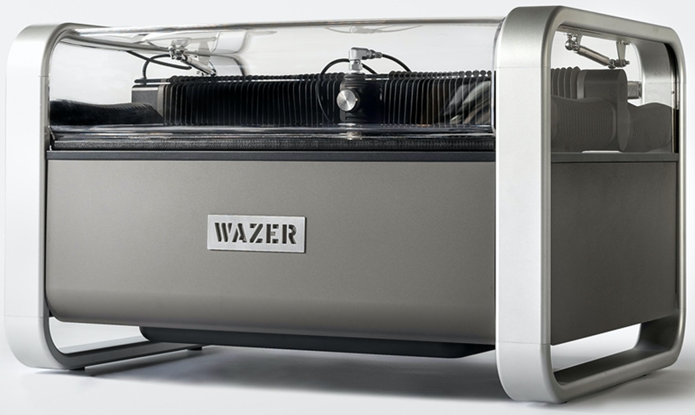
2. Mechanical (Fabrication Equipment)
Wazer Waterjet Cutter (SGD 10.6k)
Arriving mid-Mar 2021
Cut width: 1.2 mm
Processing envelope: 460 (W) x 305 (L) mm²
Designed to operate like a computer printer.
Compatible graphics editing software (TBC):
AutoCAD DXF/DWG files
CorelDRAW
Adobe Illustrator CS3 or higher
Solidworks
For cutting thicker PMMA (to 12.7 mm) & harder materials (aluminum, glass, ceramics).
You can also try approaching Mr. Anuwar/Mr. Tay at the FOE Fab Lab (E4-02-06) to use the Epilog laser cutter there.

Slide 33
2. Mechanical (Design Considerations)
Software: SOLIDWORKS (strongly recommended!) or AutoCAD.
You should use a professional CAD software to create 2D drawings and 3D models of parts as well as an assembly to have a virtual mock-up of your eventual setup, so that you can visualize and resolve any design issues before material, manpower and equipment is committed to fabricating parts.
Familiarity with Solidworks might be useful for you later on as its models are can be imported via LiveLink into COMSOL Multiphysics for simulation and HSMWorks for Computer Assisted Machining (CAM).
Dimensioning & Symbols: Millimetre (mm) or MMGS system in Solidworks.
All part designs should be standardised in mm.
⌀ is the diameter symbol for holes. More info about putting hole callouts in Solidworks can be found here.
File Formats: .DXF, .STL, .SLDPRT & .SLDASM.
We may need 2D sketches in .DXF files for use at the laser cutter, but it is not necessary if the geometries to cut is very simple (e.g. simple square & round plates) as we can sketch on the fly.
We will need to have 3D models in .STL for 3D printing or CNC machining. It is preferable to have the Solidworks part (.SLDPRT) file provided so that any on-the-fly adjustments can be made and reexported into .STL before we start the fabrication process.
Solidworks assembly (.SLDASM) or an equivalent is required so that you, your group and us can quickly assess the intended design of the overall setup and find any potential problems with part conflict or mismatch.
Reminder: You cannot make irreversible modifications to the aluminium parts, 3D printed body & micrometers provided!!!

Slide 34
2. Mechanical (Design Considerations)
Tolerance: ± 0.05 mm as a rule of thumb.
You should be aware that fabrication processes will not yield exact dimensions to the intended design. More accurate feature dimensions will require increase in tooling cost and fabrication time.
Engineering fit: Press fit or Clearance fit.
Related to tolerance, fit deals with the allowance or clearance needed for parts to successfully mate within an assembly. In general, for tight fits (i.e. press fit), parts will need to be fabricated to within 0.01 mm for the parts to be held together with friction between their surfaces.
On the other end, for a bolt to easily slide through a plate, clearance fit suffices. For example, the recommended clearance hole size for an M6 bolt (with a ⌀6 mm shaft) to pass through is ⌀6.3 mm.
Use of Metric Bolts, Screws & Nuts; Clearance & Tapping Hole Sizes.
Use only metric screws. We can tap M2, M3, M4, M6 or M8 threads.
For M3 or smaller: Use screws with flat/slot or Phillips/cross screw heads.
One source for such screws at Bell Components Pte Ltd, Sim Lim Tower #03-12.
You are provided a precision screw set to work with these small screws.
For M3 or larger: Use Hex Head Cap Screws or Hex Bolt Cap Screws.
One source for such screws at Poey Huat Hardware, Block 31, #01-20, Kelantan Lane.
You are provided adjustable wrenches, spanner set & Allen (hex) key sets to work with these screws.
Nuts: Here is a chart for Metric Nut sizes for your reference.
Refer to next slide to determine tap and clearance hole sizes for metric screws.
A list of suppliers for mechanical and electronics components can be found here.
You should try to consolidate your orders as a class to buy, to enjoy cost savings & effort spent in making a shopping trip.

Slide 35
2. Mechanical (Metric Drill Sizes)
Screw size: This is the outer diameter of the mechanical fastener’s shaft (i.e. bolt or screw).
Tap Hole: The diameter that needs to be drilled so threads can done by tapping (manual tap, or thread milling) so that the matching screw can be screwed into the hole.
Clearance Hole: The diameter for bolts to smoothly pass through the hole. This is generally oversized to accommodate for tolerances in hole placement, and can be reduced if the shafts are used for alignment and/or accuracy in the placement of holes can be guaranteed.
METRIC TAP & CLEARANCE DRILL SIZES |  | Drill Size (mm)
 |  | Tap Drill |  | Clearance Drill
Screw Size (mm) | Thread Pitch (mm) | 75% Thread for Aluminum, Brass, & Plastics | 50% Thread for Steel, Stainless, & Iron | Close Fit | Standard Fit
M 2 | 0.40 | 1.60 | 1.75 | 2.10 | 2.20
M 3 | 0.50 | 2.50 | 2.70 | 3.15 | 3.30
M 4 | 0.70 | 3.30 | 3.50 | 4.20 | 4.40
M 6 | 1.00 | 5.00 | 5.40 | 6.30 | 6.60
M 8 | 1.25 | 6.80 | 7.20 | 8.40 | 8.80
M 10 | 1.50 | 5.80 | 9.00 | 10.50 | 11.00
M 12 | 1.75 | 10.30 | 10.90 | 12.60 | 13.20

Slide 36
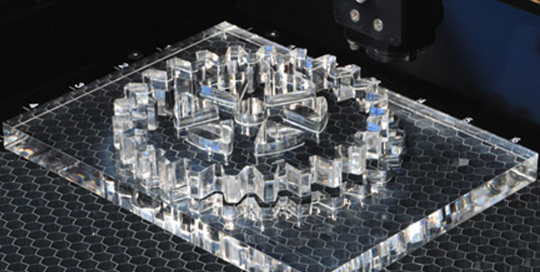

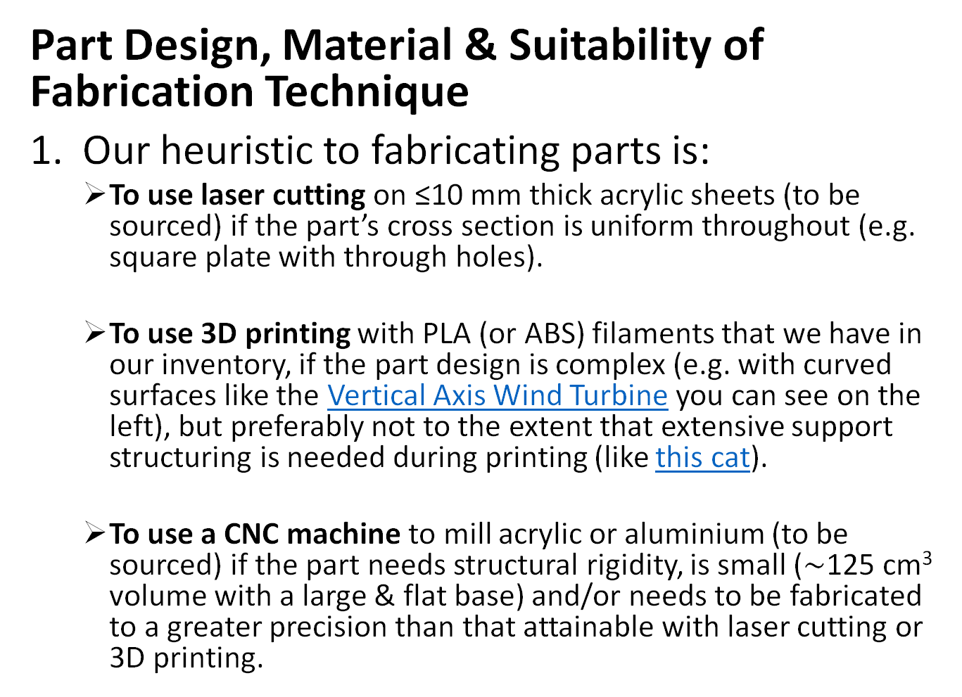
2. Mechanical (Design Process)
Laser Cutting
Part Design, Material & Suitability of Fabrication Technique
Our heuristic to fabricating parts is:
To use laser cutting on ≤10 mm thick acrylic sheets (to be sourced) if the part’s cross section is uniform throughout (e.g. square plate with through holes).
To use 3D printing with PLA (or ABS) filaments that we have in our inventory, if the part design is complex (e.g. with curved surfaces like the Vertical Axis Wind Turbine you can see on the left), but preferably not to the extent that extensive support structuring is needed during printing (like this cat).
To use a CNC machine to mill acrylic or aluminium (to be sourced) if the part needs structural rigidity, is small ($\sim$125 cm³ volume with a large & flat base) and/or needs to be fabricated to a greater precision than that attainable with laser cutting or 3D printing.
engravingsystemsllc.com
3D Printing
Ultimaker
CNC Machining
Carbide 3D

Slide 37

2. Mechanical (SOLIDWORKS)
Solidworks 2020 installer file & beginners guide (Introduction to Solidworks – Dassault Systems.pdf) can be downloaded from Teams General Channel Files.
A video guide is also available here

Slide 38
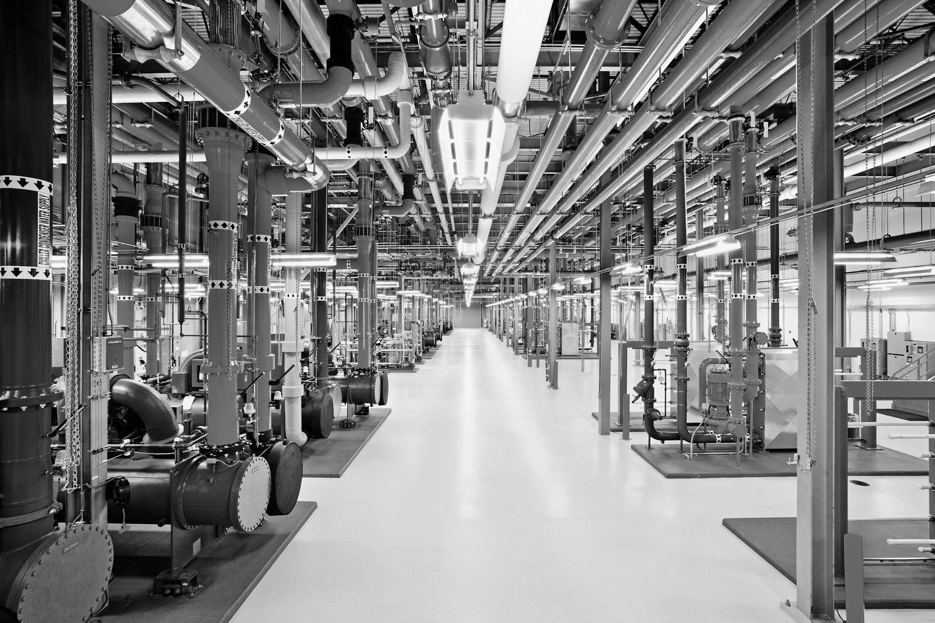
Which would you rather troubleshoot, tracing and finding potential faults in these pipes…

Slide 39
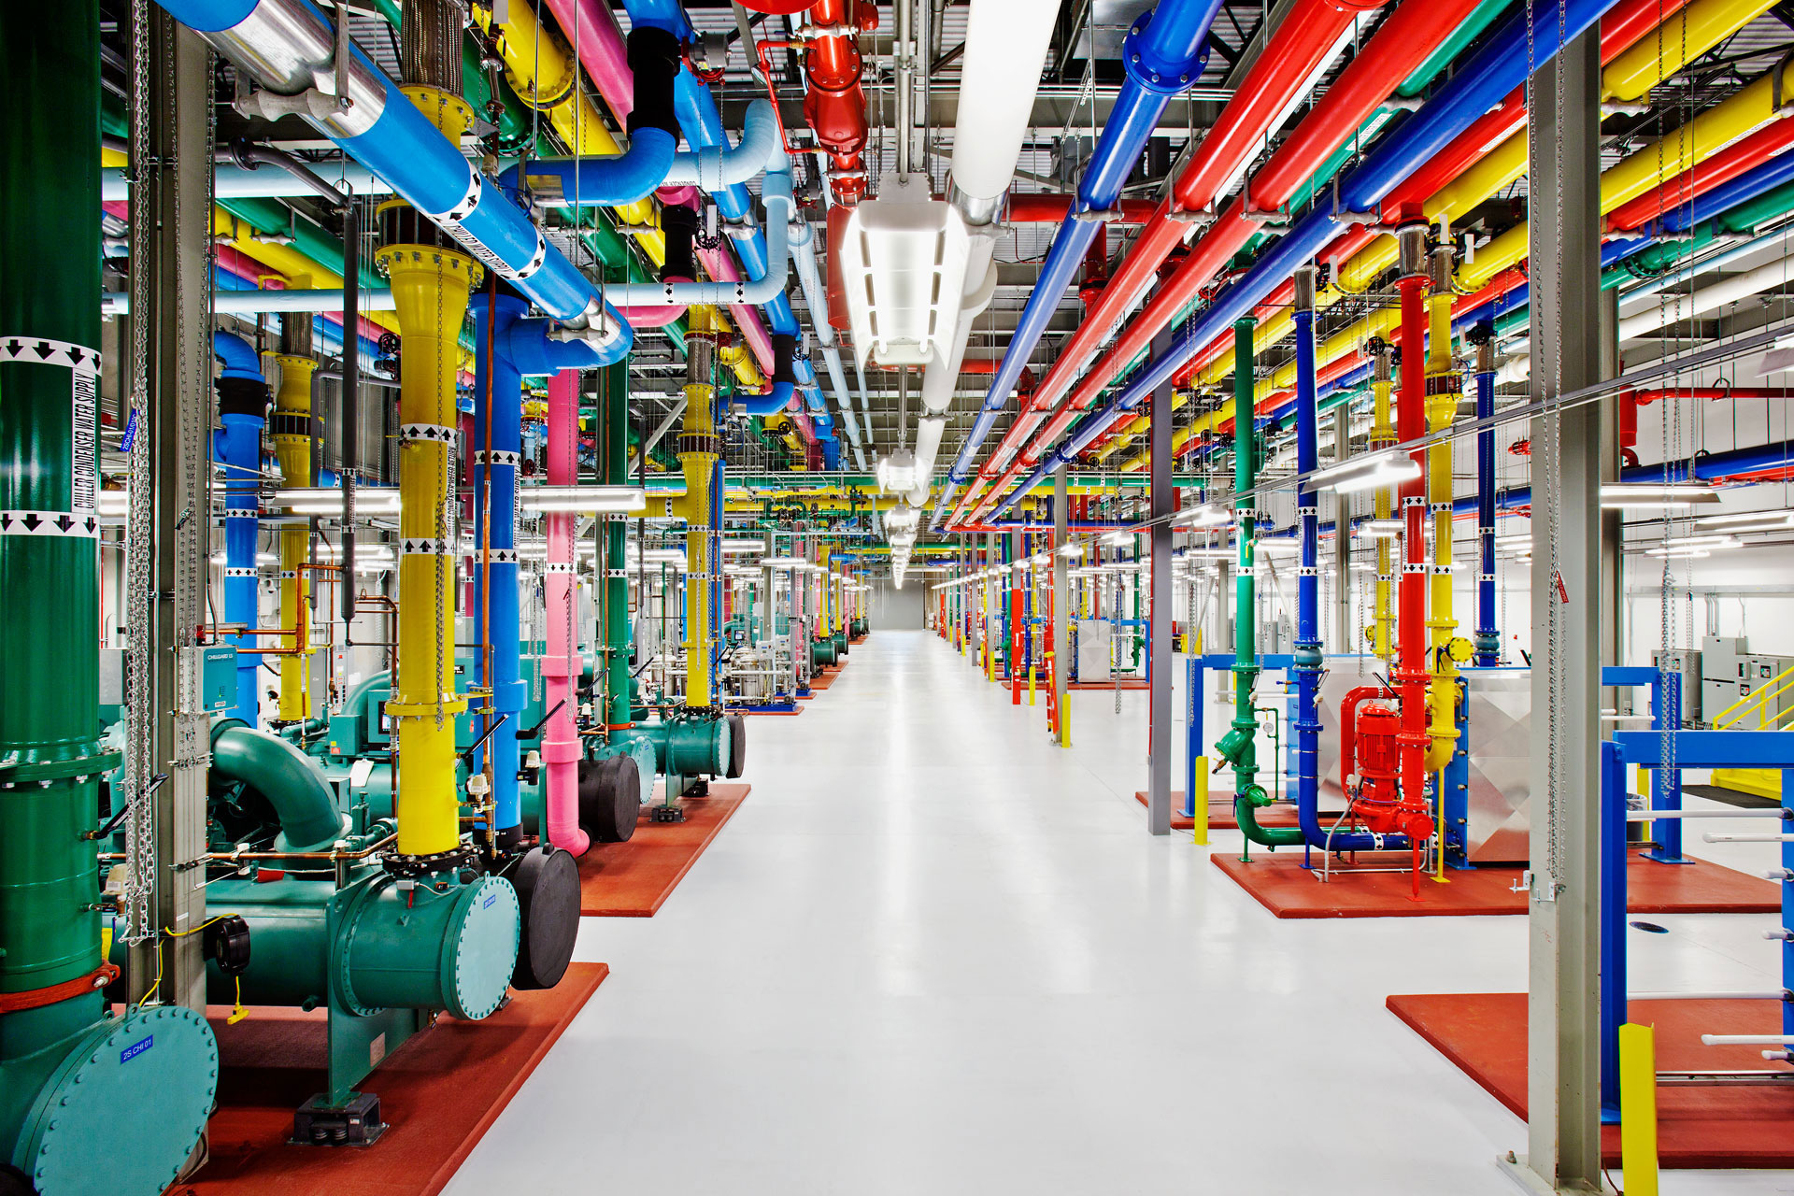
…or these pipes?
So remember to:
Use colored wires!
Avoid criss-crossing wires unnecessarily.
Label your wires!
to have good lead dress.
Image credit: Connie Zhou, Google

Slide 40
Main tasks (not exhaustive!)
Know & understand the provided PCB circuits & how it should be connected. Can you calculate the transfer functions?
Power & provide test signals to the PCB circuits to understand their output.
Assemble & integrate PCB circuits into setup.
Understand sources of noise, measure its magnitude and work to reduce noise.
Understand how data acquisition can be done, how connections are to be made, and relevant measurement parameters.

Slide 41
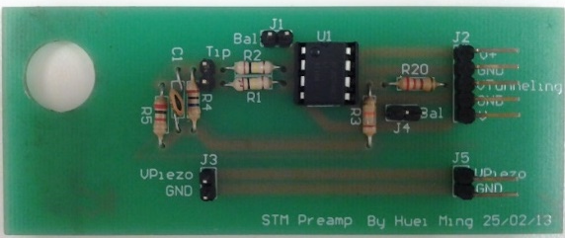
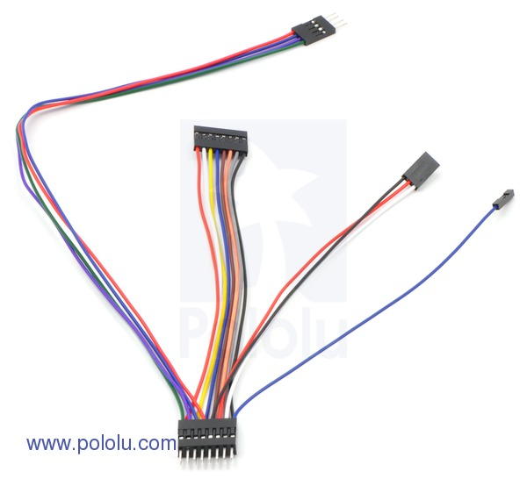
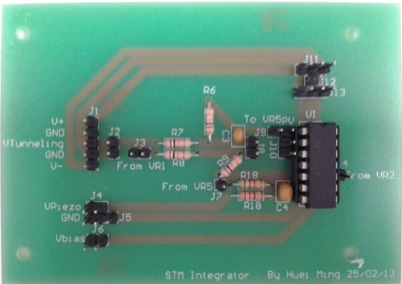
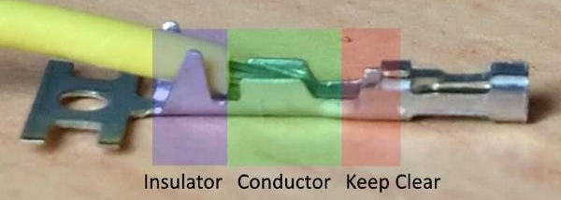
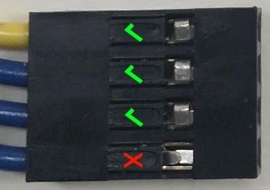
3. Electronics (PCBs & Other Connections)
You will need to understand how to use the following:
Working with wires https://learn.sparkfun.com/tutorials/working-with-wire/all
Using crimp connectors https://core-electronics.com.au/tutorials/how-to-crimp-custom-connectors.html
Soldering http://www.aaroncake.net/electronics/solder.htm
Potentiometers: http://www.electronics-tutorials.ws/resistor/potentiometer.html
Neat lead dress, properly made connectors & having a colour convention for wiring among yourselves will save you loads of headaches when troubleshooting your circuit for problems!!!

Slide 42
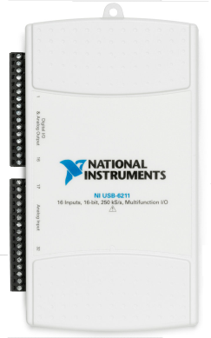
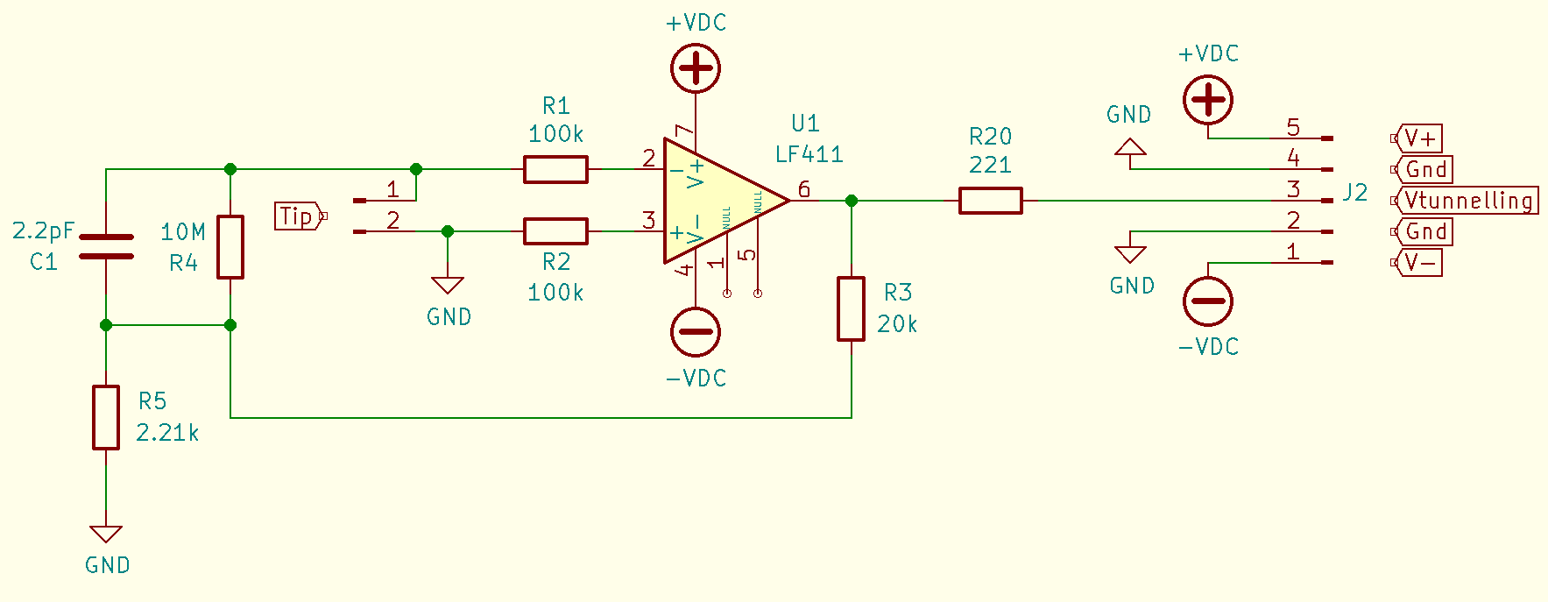
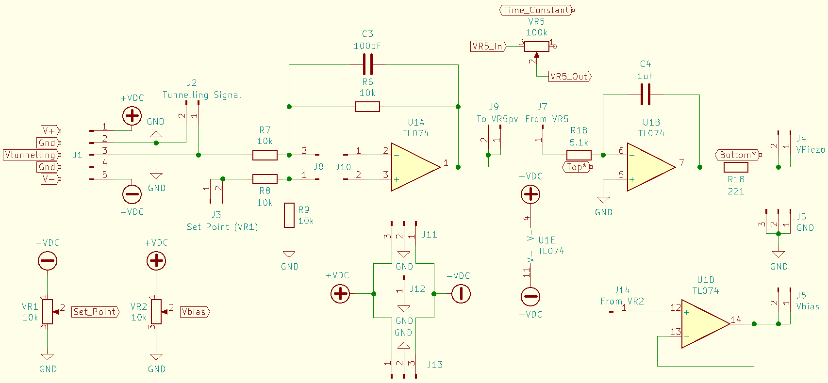
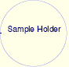


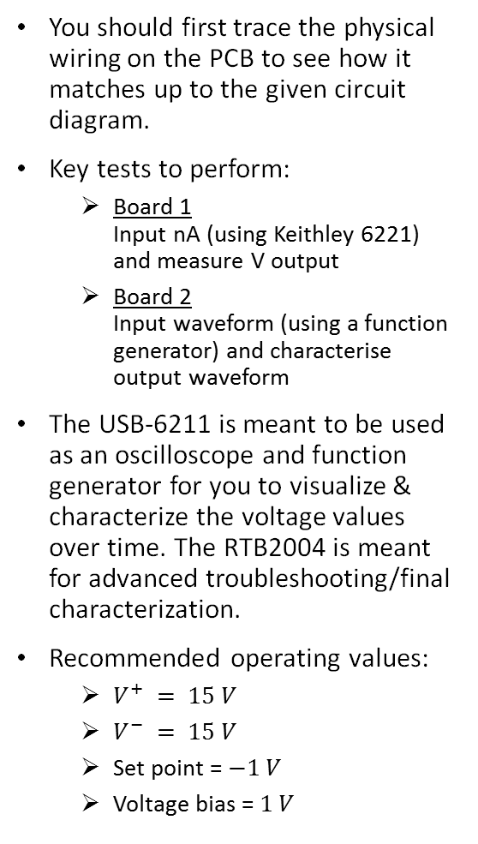
3. Electronics (Circuit)
NI USB-6211
You should first trace the physical wiring on the PCB to see how it matches up to the given circuit diagram.
Key tests to perform:
Board 1 Input nA (using Keithley 6221) and measure V output
Board 2 Input waveform (using a function generator) and characterise output waveform
The USB-6211 is meant to be used as an oscilloscope and function generator for you to visualize & characterize the voltage values over time. The RTB2004 is meant for advanced troubleshooting/final characterization.
Recommended operating values:
$V^{+} = 15 V$
$V^{−} = 15 V$
Set point = $−1 V$
Voltage bias = $1 V$
PCB 1: Pre-Amplifier
Converts I_{tunnel} to Voltage
$$V_{piezo}$$
Piezo (Z-axis)
~ 1 µm/V
$$V_{Tunneling}$$
PCB 2: Control Board
Gregory Kovacs’ EE113 Course Notes
Suggested reference for revising op-amp concepts (see relevant subchapters within Chapter 4):
Circuit diagram adapted from John D. Alexander
www.geocities.com/spm_stm/ (link defunct!)

Slide 43
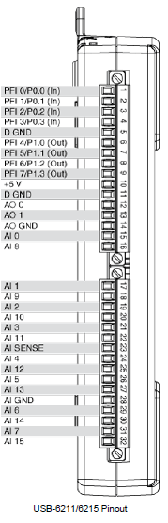
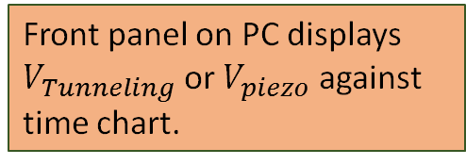
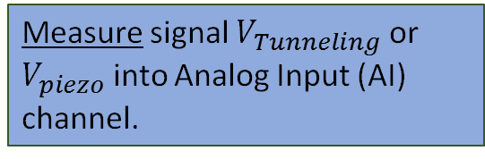
3. Electronics (USB-6211 wiring)
Data Logging (with provided LabVIEW VIs)
Acquire Input
Logging & Display Data
Measure signal $V_{Tunneling}$ or $V_{piezo}$ into Analog Input (AI) channel.
Front panel on PC displays
$V_{Tunneling}$ or $V_{piezo}$ against time chart.
Single or Continuous loop
Beware of Earth Loops!!!
(i.e. Ground everything to a single Ground point!)
Understand how it can be wired, & measurement accuracy
Difference Between Differential, RSE, and NRSE Terminal Configurations https://knowledge.ni.com/KnowledgeArticleDetails?id=kA00Z0000019QRZSA2&l=en-SG
USB-6211 Specifications https://www.ni.com/pdf/manuals/375195d.pdf

Slide 44
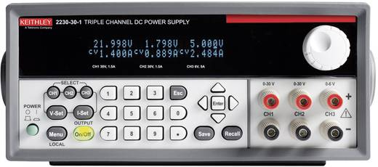

3. Electronics (Power)
The Keithley 2230G-30-1 Programmable Triple Channel DC Power Supply is provided to supply bipolar power (±10 V or ±15 V) for your analog circuits.
What is the difference between CC & CV?
Old but still working! Has:
$±15 V_{DC}$ & GND
Function Generator
V⁺
The following test leads are provided for bipolar wiring:
1x RED 0.64mm Square Pin Socket to 4mm Banana Plug
2x BLACK 0.64mm Square Pin Socket to 4mm Banana Plug
1x BLACK 4mm Banana Plug to 4mm Banana Plug
GND
V⁻

Slide 45

3. Electronics (Digital Multimeter)
Fluke 101 Digital Multimeter.
Key functions:
V_{DC} (Resolution 1 mV)
Ohm meter
Continuity test with buzzer (To test if connections are short-circuited)
Toggle using the yellow button when Ohmmeter is selected
https://www.fluke.com/en-sg/product/electrical-testing/digital-multimeters/fluke-101

Slide 46


3. Electronics (Current Source)
Keithley 6221 DC & AC low level current source.
To be used to easily verify that PCB Board 1 works.
The output is via a triax connector on the back panel (important for current signals below 1 pA).
A Keithley 7078-TRX-GND 3 slot male triax to female BNC adapter (guard removed) is available for adapting non guarded measurements. This is typically paired with the Hirschmann Black BNC Test Lead BNC to 2x 0.64mm sockets on free wires.
Interlock: Both terminal block channels needs to be shorted to function.
Setting: TRIAX OUTPUT LOW to EARTH GROUND
Setting: Compliance to 10 V
Be careful not to damage the triax adaptor or bend the RG58 coax cable less than 50 mm radius.
LIMIT: Do not exceed 100 nA current output!
To be updated
further
https://download.tek.com/manual/622x-901-01(B-Jun2005)(Ref).pdf

Slide 47

3. Electronics (Oscilloscope)
Rohde & Schwarz RTB2004 Digital Oscilloscope.
Playlist:
R&S RTB2000 Oscilloscope "How To" Videos
Key videos from playlist & elsewhere:
Overview of the Screen
Overview of the Front Panel Controls
Make Measurements
Project oscilloscope screen via LAN
Import and export of data and settings via USB
To be updated
further
https://www.rohde-schwarz.com/us/manual/r-s-rtb2000-user-manual-manuals-gb1_78701-402707.html

Slide 48


4. Drift\Stability
The Scienta Omicron LT STM lay claim to thermal drift of <0.25 Å/h and intrinsic stability of z<1 pm (left). How does your system measure up to this gold standard?
Let’s consider what is drift and what is stability so that you can perform your characterisation.
(Mean) Drift (velocity): Change in position over time in a direction. The cumulative change can be averaged over the total period of measured change to obtain a mean velocity.
Stability: The maximum amplitude (peak-to-peak) of oscillatory motion observed over a measured period. Typically, the time frame taken for stability characterisation would be over a shorter time frame compared to drift.
A key aspect is to understand the limits of your instrumentation, such as
the optical microscope you have used to characterise your piezos (what would its measurement error be?), and
the DAQ card you would be using to measure $V_{piezo}$ (what would its sensitivity and accuracy be?).
the noise (and its source) in your measurement, and how to limit the noise from your measuring instrument/setup/environment.
References:
Accuracy, Precision, Resolution & Sensitivity https://kb.mccdaq.com/KnowledgebaseArticle50043.aspx
How To Measure Voltage https://www.ni.com/tutorial/7113/en/
Tutorial: Minimizing Drift https://www.newport.com/t/minimizing-drift

Slide 49
4. Pt/Ir Tip Preparation (SGD 1/mm length)
PRACTICE ON INDIVIDUAL STRANDS OF AWG 24 7/0.2 mm WIRES
PT/IR TIPS SHOULD ONLY BE USED WHEN THE SETUP IS READY AND TESTED
Plan to introduce it from Week 10 onwards
There are designated tools for handling ONLY Pt/Ir wire. There is another set for practice at the common table.
CAUTION:
Ensure that no tiny metal pieces from the wire fly into anyone’s eyes.
Wear gloves when handling ethanol/IPA and/or cutting the tip wire.
NEVER talk/breath on any part of the STEM system. Your breath contains practically uncountable molecules of organic substances.

Slide 50
4. Pt/Ir Tip Preparation
Tools:
Erem Semi-flush wire cutter
Erem 2411PD flat nose pliers
Pointed tweezers
Rounded tweezers
Based on the figure shown (left):
Hold the end of the wire using the pliers without bending/kinking the wire.
Place the wire cutter as obliquely as possible. Close the cutters until it lightly bites into the wire.
Pull the cutter in the direction shown. Try to tear off the wire to form a tip, instead of cutting it cleanly off (why?)
Do not contaminate the tip end once cut, and carefully mount into your tip holder.
Image credit: Nanosurf STM Manual
Wear nitrile gloves
Practice on copper wires first before trying to cut your Pt/ir wire. Do keep in mind that Pt/Ir is much tougher than Cu!
If necessary, clean tools with ethanol/IPA

Slide 51



4. Pt/Ir Tip Preparation
Having a sharp tip is paramount for good STM imaging.
The material of choice for ambient experiments is platinum-iridium (90% Pt-10% Ir) alloy. Platinum is a noble metal, thus its inertness resists oxidisation. Alloying with Iridium increases strength for malleable Platinum.
Mechanical cutting of few mm long (≤4 mm), ⌀0.25 mm Pt-Ir wire is the most used method to get a fresh tip for use. Shearing when cutting Pt-Ir wire usually creates filamentary projections that can be atomically sharp which can be used to image very flat substrates (Why?). However, the know-how is in between art and science (as it takes some practice, intuition and understanding).
Caveat: Technique does not create tips with consistency and reliability achievable by electrochemical etching (but this involves use of hazardous chemicals)! Dry etched tips are commonly used in industrial units but require advanced tools & are costlier to purchase.
TEM image of a Pt/Ir tip
produced using mechanical cutting.
http://www.physics.purdue.edu/nanophys/uhvstm/tip.html

Slide 52




4. Mechanical (Vibration)
BRÜEL & KJÆR Type 2250 HAND-HELD ANALYZER
TYPE 8344 PIEZOELECTRIC ACCELEROMETER, TEDS
To be updated
further

Slide 53



4. Mechanical (Vibration)
Minus-K 25BM-4 (USD 3.1k)
WARNING: DO NOT LIFT THE ISOLATING PLATE WITHOUT THE RED LOCKING RINGS IN PLACE
To be updated
further
http://www.theanalogdept.com/minus_k.htm

Slide 54
5. Documentation (Week 8, 9, 10, 12 Updates)
4x Weekly update meeting (max. 15 mins) via Teams call with Prof. van Kan.
Primary responsibility of the Group Leader & will form his/her logbook submission. To take place during lab sessions, but on the day group leader is scheduled to be off-site. Other group members also off-site are strongly encouraged to be in the meeting.
Meetings can be hosted within your Group channels in Microsoft Teams. https://support.microsoft.com/en-us/office/start-an-instant-meeting-in-teams-ff95e53f-8231-4739-87fa-00b9723f4ef5
To start an instant channel meeting (for computer app):
Go to Teams icon on the left sidebar of the app. Choose your Group’s channel from the list.
In the Channel tab, look for Meet now icon in the top-right corner of the menu bar. Or, to keep the context of a specific conversation, choose Reply below any post, and then Meet now button under the box where you'd type your message.
Give your meeting a title and choose whether you want to include video.
When you're ready, hit Join now. Your meeting is now up and running, and anyone in the channel can join it.
To invite people:
Start typing the name or phone number of someone you want to invite in the box under People in the top right. Select them when they appear in the list, and they'll get a call right away.
This way, you can invite us to join in your group discussion easily, and we can drop-in on an ad hoc basis to see how you are progressing.

Slide 55
5. Documentation (Week 8, 9, 10, 12 Updates)
Briefing tips:
Keep update briefs short (15 mins max per group), use guiding principles from here:
https://hbr.org/2012/10/how-to-present-to-senior-execu
https://pmiwdc.org/article/lawrence-l-tracy/10-tips-help-project-managers-shine-when-they-present-senior-executives (Not working)
How to structure your brief?
Brief using the formula of a Situation Report (SITREP) https://www.thepersimmongroup.com/situation-report-sitrep-template/
Use quad chart (template provided) to streamline the update briefing. You can augment with more slides per quadrant if more space is needed but do not exceed 5 total.
Use a Gantt chart to show project progress on timeline & highlight if there are changes. https://www.projectmanager.com/gantt-chart
Generate BOM (template provided) if there are items to buy

Slide 56
5. Management Tips
Start simple, work incrementally.
Always plan for the end goal and divide and conquer: break down by subject area, and the steps needed to be taken to achieve key objectives, by visualizing ahead of time, you can try anticipating potential pitfalls and minimize time on unforeseen complications.
Always have a plan B.
Cross-train, do not be narrow minded and staying focused only on matters pertaining to your own domain.
Isn’t that why you joined ESP in the first place?
You will need to talk across domains when it comes to the integration & assembly process.
Learn to manage up, down and sideways!
Harvard Business Review is a good starting resource for this.

Slide 57
5. Management Tips
Guide to leadership roles in a technical group.
Technical leadership (i.e. Subject Matter Expert for Mechanical, Electrical, Physics, Design, System Integration, etc etc etc).
Group leadership (i.e. Program Manager that keeps an eye on the overall). This is not a glorified secretary that passively documents whatever that had happened.
A title doesn’t make a leader (although it helps significantly), it’s an accumulated respect and influence gained from fulfilling well for the responsibility given or self-assumed.
Good teamwork is a group that works in coordinated and orchestrated manner that is mutually supporting (e.g. a good LAN game or sports match).
Planning is everything, so it before lab session.
Approach lab sessions like a ranked match, sports competition, stage performance or military exercise.

Slide 58
6. Documentation (Log book)
All group members are expected to have their own logbooks.
You are encouraged to have an A4 softcopy journal.
Easier to upload for our reference.
Won’t be lost if disappear.
Hardcopy is still acceptable if you prefer it, as long as you can meet the submission requirements.
Document what YOU did in your log book, for another person to be able to clearly follow your work. You don’t get marks for being long winded and/or have illegible writing! Strive to be terse, concise and incisive!
In lieu of countersigning, you are expected to upload a PDF copy of every week’s entries by end of the week (ref. slide on upload convention).
Recommended guide:
Ian W. Hunter and Barbara Hughey, Instructions for using your lab notebook
http://web.mit.edu/me-ugoffice/communication/labnotebooks.pdf

Slide 59
6. Documentation (Final Presentation & Report)
Include Contributions section to list the authors that contributed to the respective chapters in the report and the overall editor, as well as who conceived ideas, made designs, did tests/experiments and who did literature review, calculations, etc.
Document clearly, the
Approach to designing the entire setup (include scale bar in your figures), & how you wire up your electronics.
Document your results, note down all parameter values & settings.
For physical values used, state them with the correct number of significant values and/or error bound and/or confidence value.
Know the equipment you use (who made the equipment, model name, accuracy of system)!
Visualise your data with properly annotated graphs using Excel, Origin or other suitable software. We will penalize you for using screenshots!
Include reference footnotes in text and corresponding reference in a reference list at the end of poster/report.
When writing report text, put some effort into overall organization of content, and structure your sentences such that they promote readability and easy comprehension. Being able to phrase your thoughts into the formulaic fashion typical of technical documents takes conscious thought and practice!

Slide 60
6. Documentation (Upload Convention) Upload all documents in PDF format with the following file name convention:
Example for Group 0 deliverables upload:
‘Group 0 Final Presentation’
‘Group 0 Final Report’
‘Group 0 Week n Weekly Update’
Logbook for Group 0, Member XYZ for Week number n:
Upload as PDF each week to Teams G0 Files/Logbook as ‘Group 0 XYZ Week n’.
You must upload by end of each week (i.e., Sundays 2359 hrs).
HM will compile into a full logbook at the end of the project.
*Files not submitted as specified MAY be rejected during the sort and/or penalised.

Slide 61
References (Style & Citing)
At minimum, you should read the references highlighted in red to guide you in presentation & report writing.
Recommended text:
Kelly, N. Sentence Structure of Technical Writing
<http://web.mit.edu/me-ugoffice/communication/technical-writing.pdf> (2006).
Nature Education. Scitable - English Communication for Scientists Units 2, 4 & 5.1.
<http://www.nature.com/scitable/ebooks/english-communication-for-scientists-14053993/contents>.
Barrass, R. Scientists Must Write: A Guide to Better Writing for Scientists, Engineers and Students (Taylor & Francis, 2002)
<http://www.tandfebooks.com.libproxy1.nus.edu.sg/isbn/0203994116>.
MIT Department of Mechanical Engineering. Technical Communications in Mechanical Engineering (see section on Written Reports)
<http://web.mit.edu/me-ugoffice/communication/>.
Numerous technical bodies publishes their style guide/manuals, e.g.:
American Institute of Physics (AIP). Physical Review and Notation Style <https://journals.aps.org/files/styleguide-pr.pdf>.
Nature Manuscript Formatting <http://www.nature.com/nature/authors/gta/2a_Manuscript_formatting.pdf>.

Slide 62
The End (for now) This document will be revised to include more information in the future, so stay tuned!

